Slide 1


EDU 615
Ethics and Communication for School Leaders
Week #1: Tuesday, May 17, 2016
Terrence narinesingh, ed.s.
adjunct professor
Adrian Dominican school of education
educational leadership

Slide 2

About me
2016 Harvard University Leadership Program participant
Doctoral candidate (Ph.D. in Educational Leadership)
Experience includes teacher, district instructional specialist (administrator) and Assistant Principal
Improved school grades/ratings district-wide and at current school
Short-term goal is to be a Principal and long-term goal is to be an Area Superintendent
Select Career highlights:
Santaluces High School (15% increase and grade improvement from D to A)
South Tech Academy [6-12] (12% increase and grade improvement from D to B)
Village Academy [K-12] (6% increase and grade improvement from C to B)
Olympic Heights High School (5% increase and grade improvement from B to A)
Royal Palm Beach High School (3% increase and grade improvement from D to B)

Slide 3
Icebreaker
Pair up with the educational leadership researcher next to you.
As a pair, you have 4 minutes in total to talk to each other and share vital information such as name, experiences and goals.
You will then introduce your partner to the rest of the group.

Slide 4
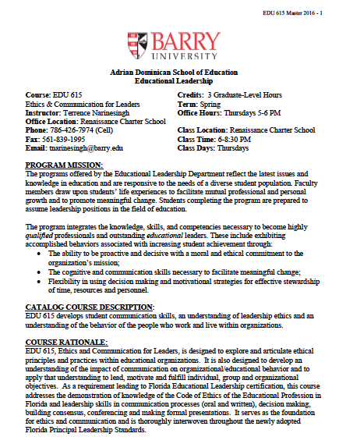
EDU 615 Syllabus Review

Slide 5

The Florida Principal
Leadership Standards
The State of FL Principal Leadership Standards addressed:
Domain 1: Student Achievement
Standard 1: Student Learning Results
Effective school leaders achieve results on the school’s
student learning goals.
Domain 4: Professional and Ethical Behaviors
Standard 10: Professional and Ethical Behaviors
Effective school leaders demonstrate personal and
professional behaviors consistent with quality practices in
education and as a community leader.

Slide 6
William Cecil Golden (WCG) School Leadership Development Program
Register for the WCG
Documentation for completion modules and work for the 10 Principal Leadership Standards
Website: www.FloridaSchoolLeaders.org

Slide 7
LiveText
Required resource for EDU 615
Used to demonstrate the quality of academic programs
One time purchase for educational leadership researchers

Slide 8

Introductions/Overview/Thoughts on Communication

Slide 9
Ethics

Slide 10
In-Basket Activity
If you have a GREEN folder with your course syllabus, your role in the activity is an elementary School Principal. You can select ONE Assistant Principal with a RED or ORANGE folder.
If you have a BLUE folder, you are a middle or high School Principal. You can select up to 3 Assistant Principals with a RED or ORANGE folder.

Slide 11
In-Basket Activity
Using the Code of Ethics of the Education Profession in Florida, examine the selected scenario and discuss the ethical dilemma.
Principals, be ready to share out in 10 minutes!

Slide 12
Wrap Up
Review
Next week’s readings
BWW Chapter 1, Ethics Chapter 1

Slide 13
References
APA (2010). Publication manual of the American Psychological Association
(6th ed.). Washington, DC: American Psychological Association.
Berko, R., Wolvin, A., & Wolvin, D. (2010). Communicating: A social, cultural and
career focus (11th ed.). Boston: Houghton Mifflin.
Strike, K.A., Haller, E.J. & Soltis, J.E. (2005). The ethics of school administration (3rd ed.).
New York: Teachers College.

