Slide 1


EDU 615
Ethics and Communication for Leaders
Week #10: Thursday, March 17, 2016
Terrence narinesingh, ed.s.
adjunct professor
Adrian Dominican school of education
educational leadership

Slide 2


Have a wonderful Spring Break!
No class on March 24

Slide 3
Agenda
Welcome
Tentative Course Calendar and Assignment
Ethical Implications Discussion
Unpacking the Florida Principal Leadership Standards
Leadership Clock Buddies Activity
Berko, R., Wolvin, A., & Wolvin, D. & Aitken, J. (2012). The concept of groups. In K. Bowers & M. Mashburn (Eds.),
Communicating: A social, cultural and career focus (12th ed.) (pp. 243-270). Boston, MA: Pearson.
Strike, K.A., Haller, E.J. & Soltis, J.F. (2005). Supplemental cases. In K.A. Strike (Ed.), The ethics of school
administration (3rd ed.) (pp. 176-177). New York, NY: Teachers College.
In-Class Reflection and Weekly Reflections and Summary Paper Feedback
Embedded scenario/role play collaboration
Problem-based Learning using the Florida Principal Leadership Standards
Next Week: Ongoing readings, scenario/role play presentation, and ethical dilemma discussion

Slide 4
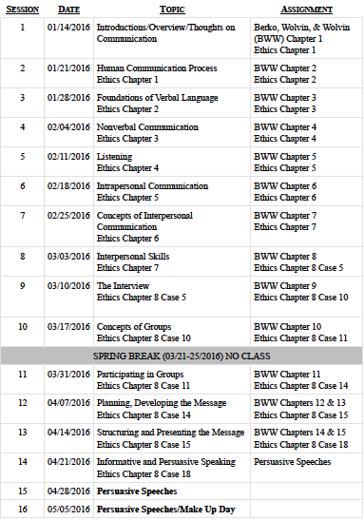
Tentative Course

Slide 5
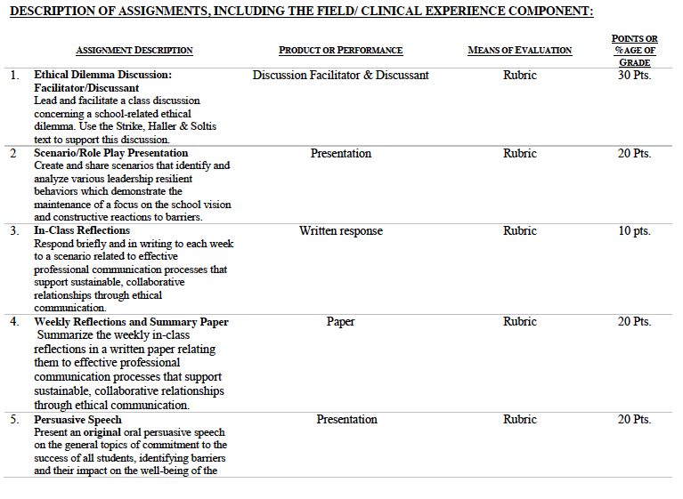

Slide 6
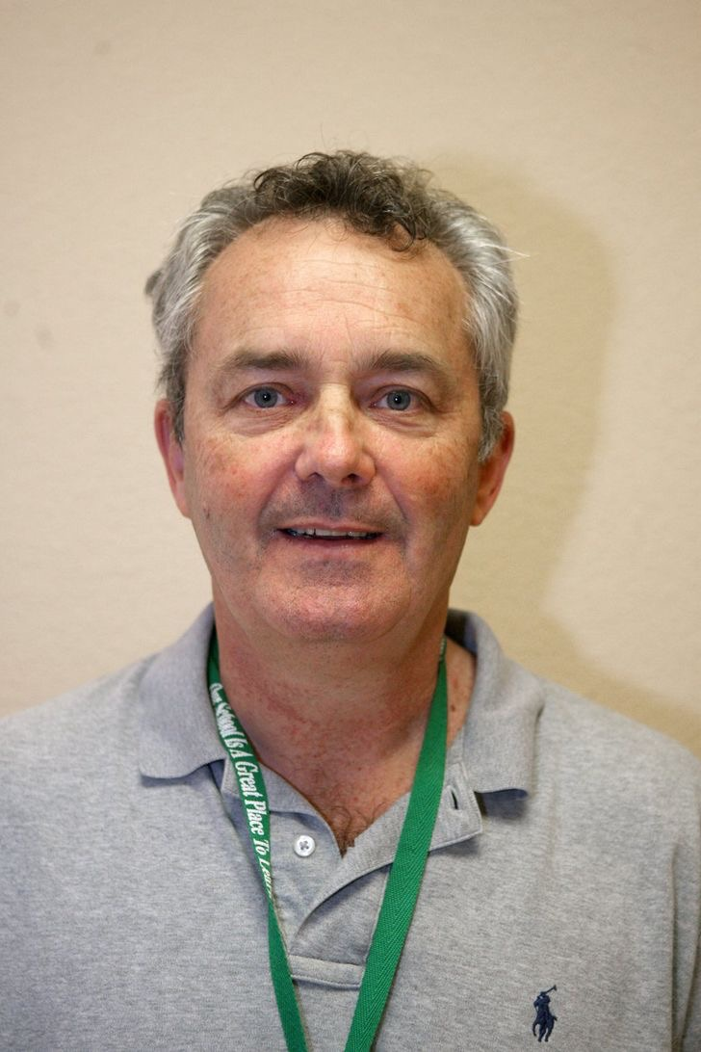
Consider the ethical implications
Police: Ex-PBC principal caught selling school district books online
January 6, 2016
Richard Hughes, Principal
http://www.mypalmbeachpost.com/news/news/local-education/police-ex-pbc-principal-caught-selling-school-dist/npyq5/

Slide 7

Unpacking the Florida Principal Leadership Standards
The State of FL Principal Leadership Standards addressed:
Domain 1: Student Achievement
Standard 1: Student Learning Results
Effective school leaders achieve results on the school’s
student learning goals.
Domain 4: Professional and Ethical Behaviors
Standard 10: Professional and Ethical Behaviors
Effective school leaders demonstrate personal and
professional behaviors consistent with quality practices in
education and as a community leader.

Slide 8
Leadership Clock Buddies
Purpose:
To support collaborative educational leadership researcher pairs for effective leadership communication.
Instructions:
Book an appointment with 12 different educational leadership researchers (one for each hour of the leadership clock).
Ensure that you both record the appointment on the leadership clocks.
Book the appointment if there is a vacant slot at the hour for both of your leadership clocks.
Terrence’s Leadership Clock EDU 615
Martha
Karen

Slide 9

STAR Targeted Selection Interviewing
Elements of the STAR:
S/T - Situation/Task That You Faced
Example: Describe a situation…
A - Actions That You Took
Example: What steps did you do in the situation?
R - Results or changes caused by these actions
Example: What were the results?

Slide 10
STAR Targeted Selection Interviewing
RATING SCALE
1 | Much less than acceptable
2 | Less than acceptable
3 | Acceptable
4 | More than acceptable
5 | Much more than acceptable

Slide 11
Chapter 9: The Concept of Groups
Define what a group is and compare and contrast large and small groups.
Explain the advantages and disadvantages of group decision making.
List and define the kinds of groups.
Explain and illustrate the norming, storming, conforming, performing, and adjourning group phases.
Apply the Six-Step Standard for Decision Making and the Berko 1-3-6 Decision-Making technique.
Define voting and explain the four common voting methods: consensus, majority, plurality, and part of whole.
Analyze the role of the setting in group actions.
Explain the various types of mediated meetings.

Slide 12
Chapter 8: Supplemental Cases
Case #10: Borrowed Property
Turn and Talk
How would you handle this matter? Would you inform McIverson, the school principal? Why or why not?
If you would not, are you not, in effect, an accomplice to an act of theft?
What procedures might a school district implement to curtail theft of the public’s property by a few employees, while still treating the vast majority of its staff as honest people?
Are Tom Wicks’s personal motives relevant to informing his superior of Fred’s actions? If so, how?

Slide 13
Scenario/Role Play (20 points)
Create and share scenarios that identify and analyze various leadership resilient behaviors which demonstrate the maintenance of a focus on the school vision and constructive reactions to barriers.
Ethical Dilemma Discussion Facilitator/Discussant (30 points)
Lead and facilitate a class discussion concerning a school-related ethical dilemma using supporting details from the text.
Admin Team 1
Mercie
Roseline
Tamar
Karen
Francesca
Admin Team 2
Patience
Jeralene
Rebecca
Jennifer
Cindy
Admin Team 3
Monica
Joshua
Martha
Barbara
Litzrudy

Slide 14

In-Class Reflection (best sample)
Respond briefly and in writing each week to a scenario related to effective professional communication processes that support sustainable, collaborative relationships through ethical communication.
You may use the scenario in the assigned textbook chapter or one that was discussed in class.
The length should be at least one full page, typed, double spaced, Times New Roman font size 12.
Must have a cover page and reference page(s).
Use APA format (refer to the APA manual and page 9 of the syllabus).
Refer to the Written In-Class Assignment Rubric in page 19 of the syllabus.
Bring a copy to class for discussion.

Slide 15
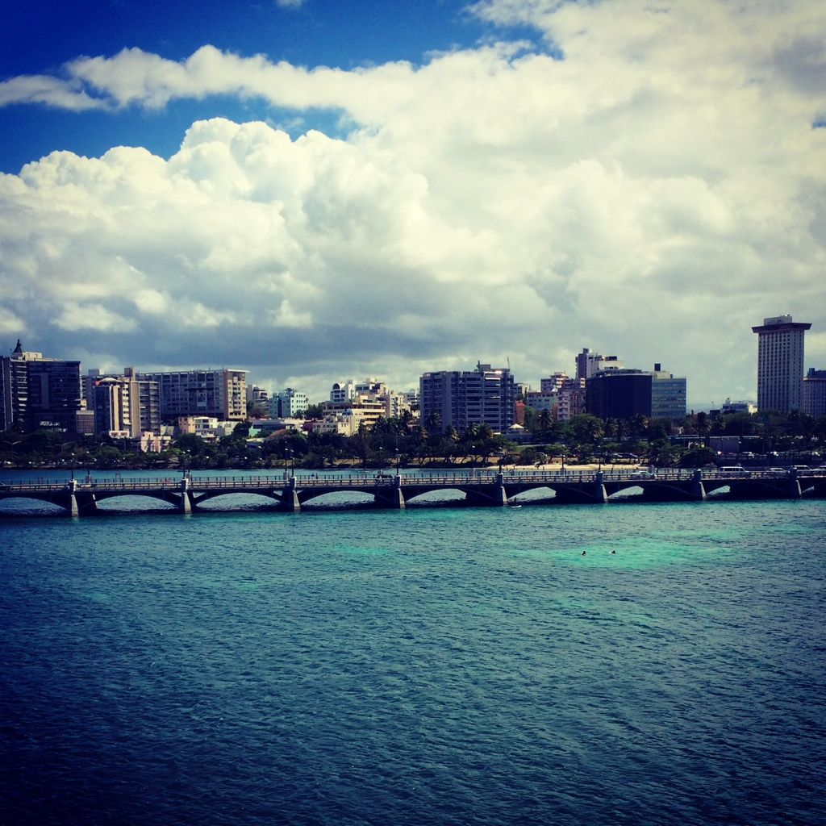
Weekly Reflections and Summary Paper (ongoing)
Summarize the weekly in-class reflections in a written paper relating them to effective professional communication processes that support sustainable, collaborative relationships through ethical communication.
Double spaced, Times New Roman, font size 12.
Must have a cover page and reference page(s).
Use APA format (refer the APA manual and page 9 of the syllabus).
Bring a copy to class for discussion.

Slide 16
Embedded Scenario/Role Play Presentation Collaboration
Create and share scenarios that identify and analyze various leadership resilient behaviors which demonstrate the maintenance of a focus on the school vision and constructive reactions to barriers.
Relevant Scenario
Develop Storyboard
Assign Roles
Act Your Role
Debrief
Identify the Problem Find a Solution

Slide 17
In-Basket Activity
If you have a GREEN folder with your course syllabus, your role in the activity is an elementary School Principal. You can select ONE Assistant Principal with a RED or ORANGE folder.
If you have a BLUE folder, you are a middle or high School Principal. You can select up to 3 Assistant Principals with a RED or ORANGE folder.
ELEMENTARY PRINCIPAL
MIDDLE/HIGH PRINCIPAL

Slide 18
In-Basket Activity
Using the Code of Ethics of the Education Profession in Florida and the Florida Principal Leadership Standards, examine the assigned scenario.
1. What possible issues/concerns might this scenario raise?
2. How could this situation become a violation of the law, the “Code” or other school/district policies?
3. In this situation, what are some potential negative consequences for the teacher/administrator, for the students and the school community?
4. What responses/actions will result in a more positive outcome and/or what proactive measures might be considered?
Principals, be ready to share out in 10 minutes!

Slide 19
Wrap Up
Review
Next week assignments:
Readings - BWW Chapter 10, Ethics Chapter 8 (Case 11)
Preparation for Scenario/Role Play Presentation (refer to the Communication rubric on the EDU 615 syllabus)
Preparation for the Ethical Dilemma

Slide 20
References
APA (2010). Publication manual of the American Psychological Association (6th ed.). Washington, DC: American Psychological Association.
Berko, R., Wolvin, A., & Wolvin, D. & Aitken, J. (2012). The concept of groups. In K. Bowers & M. Mashburn (Eds.), Communicating: A social, cultural and
career focus (12th ed.) (pp. 243-270). Boston, MA: Pearson.
Florida School Leaders. (2016, January). The William Cecil Golden school leadership development program. Retrieved from the Florida Department of
Education website http://www.floridaschoolleaders.org
Marra, A. (2016, January). Police: Ex-PBC principal caught selling school district books online. Palm Beach Post. Retrieved from http://
www.mypalmbeachpost.com/news/news/local-education/police-ex-pbc-principal-caught-selling-school-dist/npyq5/
Strike, K.A., Haller, E.J. & Soltis, J.F. (2005). Supplemental cases. In K.A. Strike (Ed.), The ethics of school administration (3rd ed.)
(pp. 176-177). New York, NY: Teachers College.

