Slide 1


EDU 615
Ethics and Communication for Leaders
Week #11: Thursday, March 31, 2016
Terrence narinesingh, ed.s.
adjunct professor
Adrian Dominican school of education
educational leadership

Slide 2

Agenda
Welcome
SMART Goal Setting and Action Plan
Tentative Course Calendar and Assignment
Ethical Implications Discussion
Unpacking the Florida Principal Leadership Standards
Leadership Clock Buddies Activity
Berko, R., Wolvin, A., & Wolvin, D. & Aitken, J. (2012). Participating in groups. In K. Bowers & M. Mashburn (Eds.),
Communicating: A social, cultural and career focus (12th ed.) (pp. 271-292). Boston, MA: Pearson.
Strike, K.A., Haller, E.J. & Soltis, J.F. (2005). Supplemental cases. In K.A. Strike (Ed.), The ethics of school
administration (3rd ed.) (pp. 177-179). New York, NY: Teachers College.
In-Class Reflection and Weekly Reflections and Summary Paper Feedback
Embedded scenario/role play collaboration
Problem-based Learning using the Florida Principal Leadership Standards
Next Week: Ongoing readings, scenario/role play presentation, and ethical dilemma discussion

Slide 3
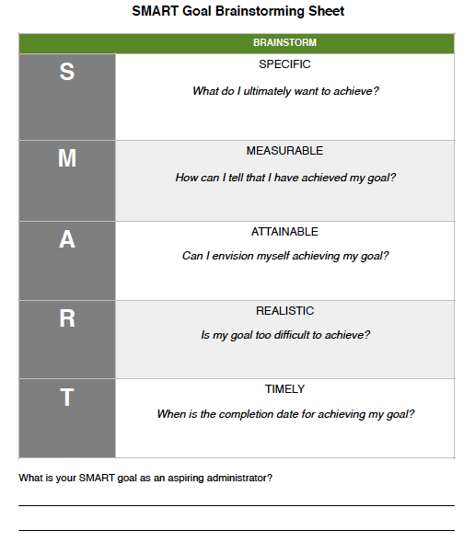
SMART Goal Setting
Example:
By July 2019, I will complete all courses toward my Master’s degree in Educational Leadership at Barry University, pass the FELE, and fulfill all entry requirements for the Aspiring Leaders Academy-1 to be an Assistant Principal.

Slide 4
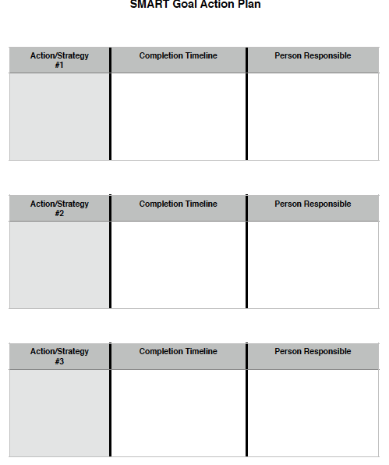
SMART Action Plan
Brainstorm:
Action/Strategy
Completion Timeline
Person Responsible

Slide 5
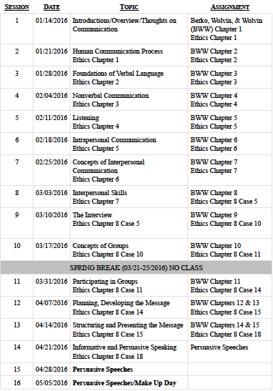
Tentative Course

Slide 6
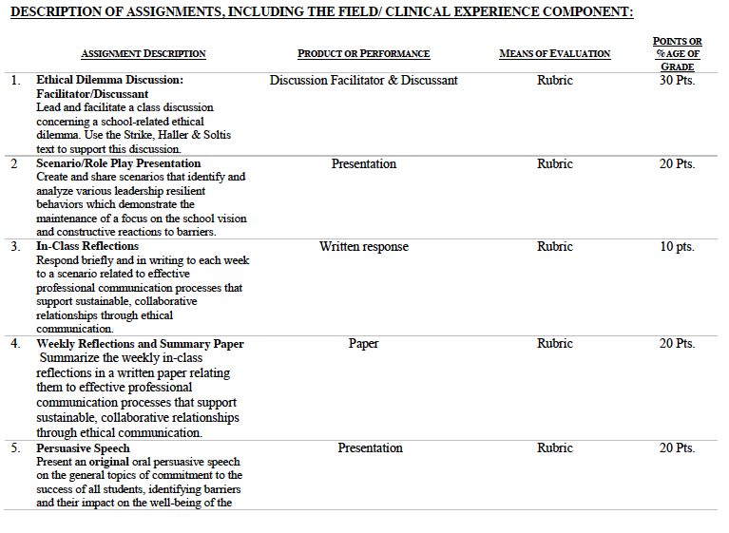

Slide 7
Consider the ethical implications
Florida principal at school where fire-breather caught on fire violated district rules by booking stuntman for pep rally
March 18, 2016
Tara Delgrotti-Ocampo, Principal
http://www.nydailynews.com/news/national/fla-principal-violated-policy-hiring-fire-breather-article-1.2569349

Slide 8

Unpacking the Florida Principal Leadership Standards
The State of FL Principal Leadership Standards addressed:
Domain 1: Student Achievement
Standard 1: Student Learning Results
Effective school leaders achieve results on the school’s
student learning goals.
Domain 4: Professional and Ethical Behaviors
Standard 10: Professional and Ethical Behaviors
Effective school leaders demonstrate personal and
professional behaviors consistent with quality practices in
education and as a community leader.

Slide 9
Leadership Clock Buddies
Purpose:
To support collaborative educational leadership researcher pairs for effective leadership communication.
Instructions:
Book an appointment with 12 different educational leadership researchers (one for each hour of the leadership clock).
Ensure that you both record the appointment on the leadership clocks.
Book the appointment if there is a vacant slot at the hour for both of your leadership clocks.
Terrence’s Leadership Clock EDU 615
Jennifer
Monica

Slide 10
Chapter 10:
Participating in groups (pp. 271-292)
Explain how people from different cultures possess varying attitudes about being group participants, applying procedures for working in groups, making decisions, following procedural structure, and using information.
Discuss the role of gender as a factor in group activities.
Define and explain the role of the participants, the leaders, and the leadership in groups.
Compare and contrast the role of disagreement in the group process.
Evaluate the role of hidden agenda in the group process.
Define the autocratic, participatory and free rein leader types.
Analyze why a person would want to be a group leader and demonstrate how he or she would proceed to acquire the leader or leadership role.

Slide 11
Chapter 8: Supplemental Cases
Case #11: An office affair (pp.177-179)
Turn and Talk
People - both married and unmarried - have affairs all the time. Is there anything about an affair between educators that makes it more problematic than most others?
Superiors and subordinates also have affairs all the time. Is there anything about such a relationship between principal and teacher that makes it especially problematic?
Suppose it was true that Bill is a superb teacher and that Ludlow Junior High is actually running better because of its principal’s dalliance. If you were Susan Matheson, how would you handle the situation?

Slide 12

STAR Targeted Selection Interviewing
Elements of the STAR:
S/T - Situation/Task That You Faced
Example: Describe a situation…
A - Actions That You Took
Example: What steps did you do in the situation?
R - Results or changes caused by these actions
Example: What were the results?

Slide 13
STAR Targeted Selection Interviewing
RATING SCALE
1 | Much less than acceptable
2 | Less than acceptable
3 | Acceptable
4 | More than acceptable
5 | Much more than acceptable

Slide 14
Scenario/Role Play (20 points)
Create and share scenarios that identify and analyze various leadership resilient behaviors which demonstrate the maintenance of a focus on the school vision and constructive reactions to barriers.
Ethical Dilemma Discussion Facilitator/Discussant (30 points)
Lead and facilitate a class discussion concerning a school-related ethical dilemma using supporting details from the text.
Admin Team 1
Mercie
Roseline
Tamar
Karen
Francesca
Admin Team 2
Patience
Jeralene
Rebecca
Jennifer
Cindy
Admin Team 3
Monica
Joshua
Martha
Barbara
Litzrudy

Slide 15

In-Class Reflection (best sample)
Respond briefly and in writing each week to a scenario related to effective professional communication processes that support sustainable, collaborative relationships through ethical communication.
You may use the scenario in the assigned textbook chapter or one that was discussed in class.
The length should be at least one full page, typed, double spaced, Times New Roman font size 12.
Must have a cover page and reference page(s).
Use APA format (refer to the APA manual and page 9 of the syllabus).
Refer to the Written In-Class Assignment Rubric in page 19 of the syllabus.
Bring a copy to class for discussion.

Slide 16
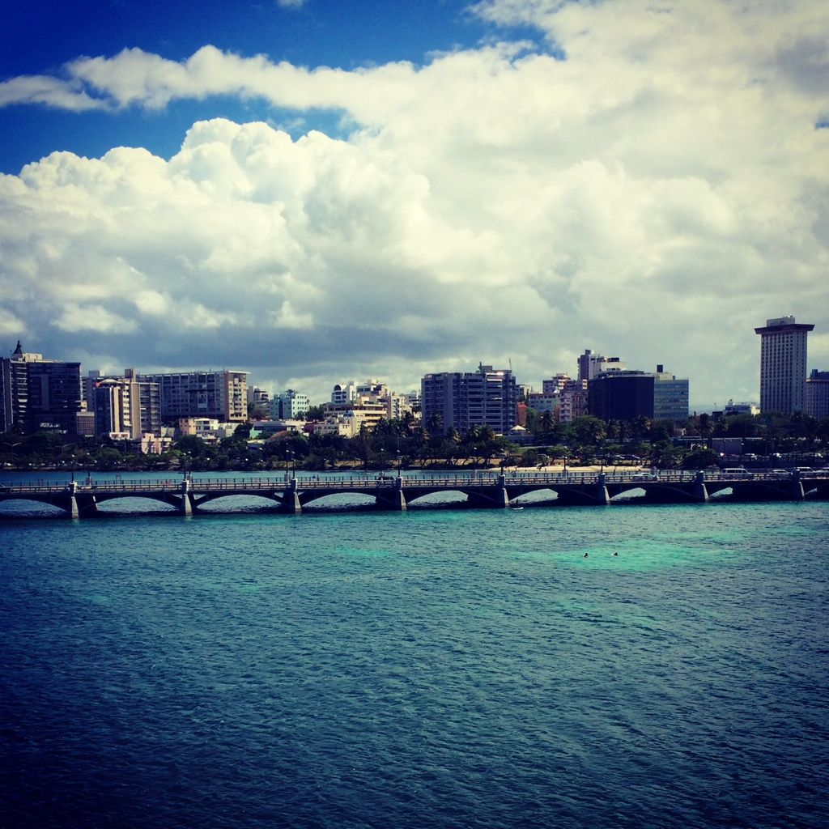
Weekly Reflections and Summary Paper (ongoing)
Summarize the weekly in-class reflections in a written paper relating them to effective professional communication processes that support sustainable, collaborative relationships through ethical communication.
Double spaced, Times New Roman, font size 12.
Must have a cover page and reference page(s).
Use APA format (refer the APA manual and page 9 of the syllabus).
Bring a copy to class for discussion.

Slide 17
Embedded Scenario/Role Play Presentation Collaboration
Create and share scenarios that identify and analyze various leadership resilient behaviors which demonstrate the maintenance of a focus on the school vision and constructive reactions to barriers.
Relevant Scenario
Develop Storyboard
Assign Roles
Act Your Role
Debrief
Identify the Problem Find a Solution

Slide 18
In-Basket Activity
If you have a GREEN folder with your course syllabus, your role in the activity is an elementary School Principal. You can select ONE Assistant Principal with a RED or ORANGE folder.
If you have a BLUE folder, you are a middle or high School Principal. You can select up to 3 Assistant Principals with a RED or ORANGE folder.
ELEMENTARY PRINCIPAL
MIDDLE/HIGH PRINCIPAL

Slide 19
In-Basket Activity
Using the Code of Ethics of the Education Profession in Florida and the Florida Principal Leadership Standards, examine the assigned scenario.
1. What possible issues/concerns might this scenario raise?
2. How could this situation become a violation of the law, the “Code” or other school/district policies?
3. In this situation, what are some potential negative consequences for the teacher/administrator, for the students and the school community?
4. What responses/actions will result in a more positive outcome and/or what proactive measures might be considered?
Principals, be ready to share out in 10 minutes!

Slide 20
Wrap Up
Review
Next week assignments:
Readings - BWW Chapter 11, Ethics Chapter 8 (Case 14)
Preparation for Scenario/Role Play Presentation (refer to the Communication rubric on the EDU 615 syllabus)
Preparation for the Ethical Dilemma

Slide 21
References
APA (2010). Publication manual of the American Psychological Association (6th ed.). Washington, DC: American Psychological Association.
Berko, R., Wolvin, A., & Wolvin, D. & Aitken, J. (2012). Participating in groups. In K. Bowers & M. Mashburn (Eds.), Communicating: A social, cultural and
career focus (12th ed.) (pp. 2471-292). Boston, MA: Pearson.
Florida School Leaders. (2016, January). The William Cecil Golden school leadership development program. Retrieved from the Florida Department of
Education website http://www.floridaschoolleaders.org
Strike, K.A., Haller, E.J. & Soltis, J.F. (2005). Supplemental cases. In K.A. Strike (Ed.), The ethics of school administration (3rd ed.)
(pp. 177-179). New York, NY: Teachers College.
Wagner, M. (2016, March). Florida principal at school where fire-breather caught fire violated district rules by booking stuntman for pep rally. New York
Daily News. Retrieved from http://www.nydailynews.com/news/national/fla-principal-violated-policy-hiring-fire-breather-article-1.2569349

