Slide 1


EDU 615
Ethics and Communication for Leaders
Week #12: Thursday, April 7, 2016
Terrence narinesingh, ed.s.
adjunct professor
Adrian Dominican school of education
educational leadership

Slide 2

Agenda
Welcome
SMART Goal Setting and Action Plan
Tentative Course Calendar and Assignment Due Dates
Ethical Implication Discussion
Unpacking the Florida Principal Leadership Standards
Leadership Clock Buddies Activity
Berko, R., Wolvin, A., & Wolvin, D. & Aitken, J. (2012). Public speaking: planning the message. In K. Bowers & M. Mashburn
(Eds.), Communicating: A social, cultural and career focus (12th ed.) (pp. 293-318). Boston, MA: Pearson.
Strike, K.A., Haller, E.J. & Soltis, J.F. (2005). Supplemental cases. In K.A. Strike (Ed.), The ethics of school
administration (3rd ed.) (pp. 181-182). New York, NY: Teachers College.
In-Class Reflection and Weekly Reflections and Summary Paper Feedback
Embedded scenario/role play collaboration
Problem-based Learning using the Florida Principal Leadership Standards
Next Week: Ongoing readings, scenario/role play presentation, and ethical dilemma discussion

Slide 3
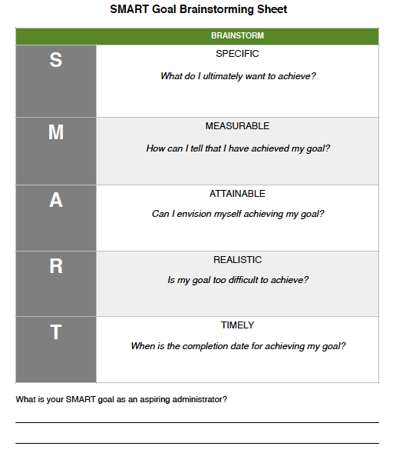
SMART Goal Setting
Example:
By July 2019, I will complete all courses toward my Master’s degree in Educational Leadership at Barry University, pass the FELE, and fulfill all entry requirements for the Aspiring Leaders Academy-1 to be an Assistant Principal.

Slide 4
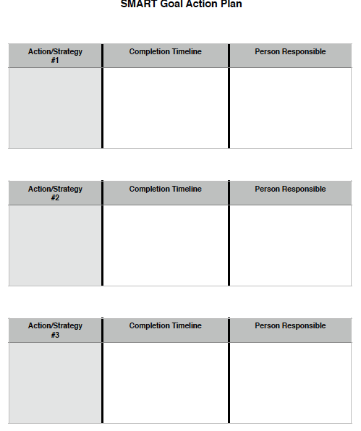
SMART Action Plan
Brainstorm:
Action/Strategy
Completion Timeline
Person Responsible

Slide 5
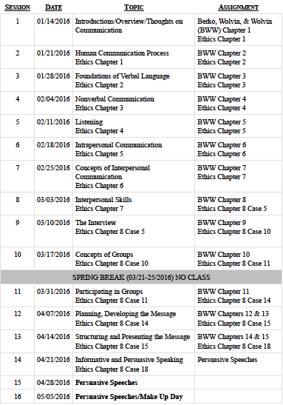
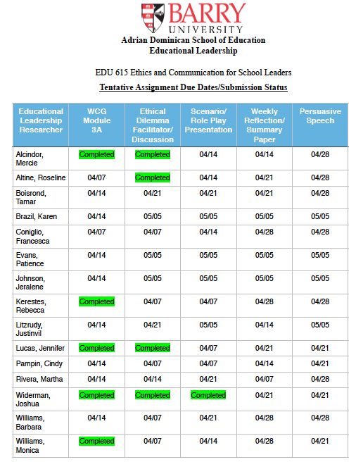

Slide 6
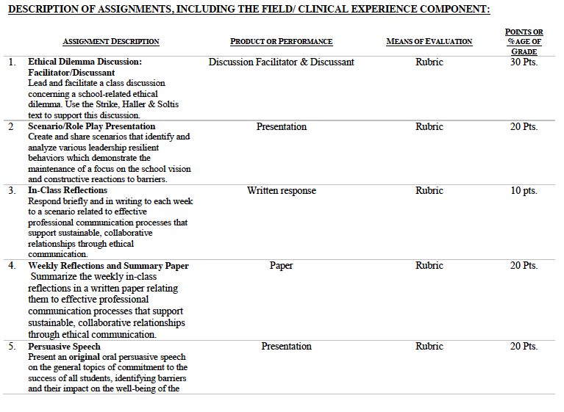

Slide 7
Consider the ethical implications
Del Prado elementary school principal demoted
August 4, 2010
Sandra Rhategan, Principal
http://articles.sun-sentinel.com/2010-08-04/news/fl-principal-demotion-palm-beach-20100804_1_sandra-rhategan-school-board-board-members

Slide 8

Unpacking the Florida Principal Leadership Standards
The State of FL Principal Leadership Standards addressed:
Domain 1: Student Achievement
Standard 1: Student Learning Results
Effective school leaders achieve results on the school’s
student learning goals.
Domain 4: Professional and Ethical Behaviors
Standard 10: Professional and Ethical Behaviors
Effective school leaders demonstrate personal and
professional behaviors consistent with quality practices in
education and as a community leader.

Slide 9
Leadership Clock Buddies
Purpose:
To support collaborative educational leadership researcher pairs for effective leadership communication.
Instructions:
Book an appointment with 12 different educational leadership researchers (one for each hour of the leadership clock).
Ensure that you both record the appointment on the leadership clocks.
Book the appointment if there is a vacant slot at the hour for both of your leadership clocks.
Terrence’s Leadership Clock EDU 615
Roseline

Slide 10
Chapter 11:
Public speaking:
Planning the message (pp. 293-318)
Define public communication/public speaking.
Formulate a listenable speech.
Explain the ethical responsibility of a public speaker, including the implications of plagiarism and fabrication.
Explain the role of the participants, setting, and purpose/topic of public communication.
Define and explain the roles of prior, process, and post speech analyses.
Clarify the role of the statement of the central idea of a public speech.
Discuss how to develop impromptu (or ad lib), extemporaneous, manuscript, and memorized presentations.
Compare and contrast the advantages and disadvantages of the impromptu, extemporaneous, manuscript, and memorized modes of presentation.

Slide 11
Chapter 8: Supplemental Cases
Case #14: Confidentiality, obligations, and friendship (pp.181-182)
Turn and Talk
If you were Henry, what would you decide?
How would you justify your decision?
Did the nature of the disease influence your decision?
Are personal relations and any degree of friendship between administrators and staff best avoided?

Slide 12

STAR Targeted Selection Interviewing
Elements of the STAR:
S/T - Situation/Task That You Faced
Example: Describe a situation…
A - Actions That You Took
Example: What steps did you do in the situation?
R - Results or changes caused by these actions
Example: What were the results?

Slide 13
STAR Targeted Selection Interviewing
RATING SCALE
1 | Much less than acceptable
2 | Less than acceptable
3 | Acceptable
4 | More than acceptable
5 | Much more than acceptable

Slide 14
Scenario/Role Play (20 points)
Create and share scenarios that identify and analyze various leadership resilient behaviors which demonstrate the maintenance of a focus on the school vision and constructive reactions to barriers.
Ethical Dilemma Discussion Facilitator/Discussant (30 points)
Lead and facilitate a class discussion concerning a school-related ethical dilemma using supporting details from the text.
Admin Team 1
Mercie
Roseline
Tamar
Karen
Francesca
Admin Team 2
Patience
Jeralene
Rebecca
Jennifer
Cindy
Admin Team 3
Monica
Joshua
Martha
Barbara
Litzrudy

Slide 15

In-Class Reflection
Respond briefly and in writing each week to a scenario related to effective professional communication processes that support sustainable, collaborative relationships through ethical communication.
You may use the scenario in the assigned textbook chapter or one that was discussed in class.
The length should be at least one full page, typed, double spaced, Times New Roman font size 12.
Must have a cover page and reference page(s).
Use APA format (refer to the APA manual and page 9 of the syllabus).
Refer to the Written In-Class Assignment Rubric in page 19 of the syllabus.
Bring a copy to class for discussion.

Slide 16
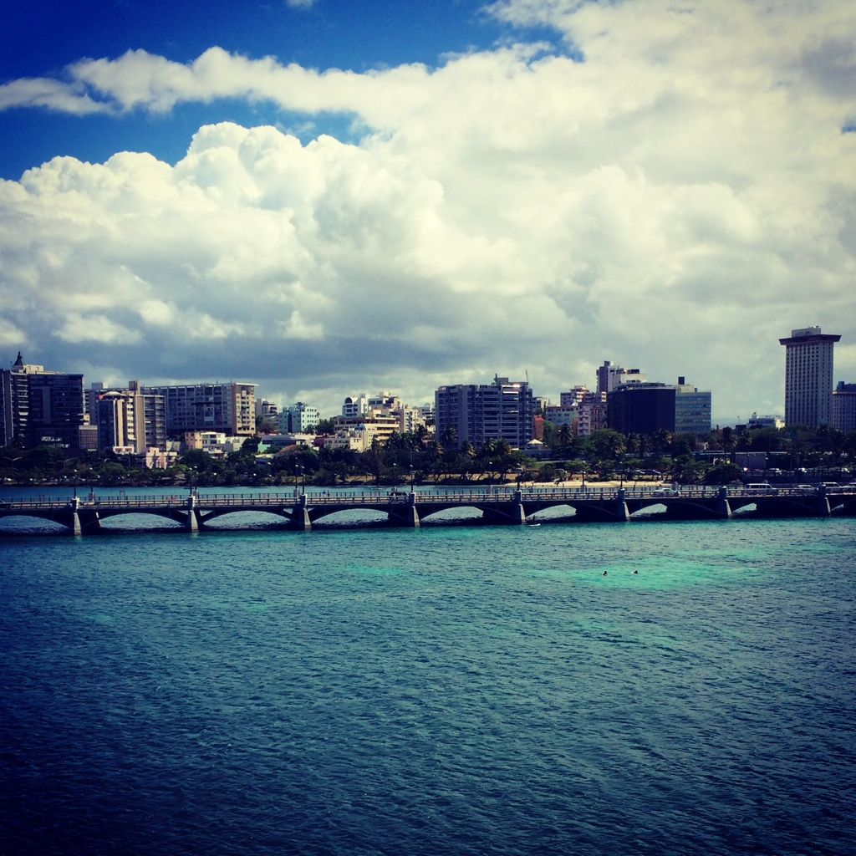
Weekly Reflections and Summary Paper (ongoing)
Summarize the weekly in-class reflections in a written paper relating them to effective professional communication processes that support sustainable, collaborative relationships through ethical communication.
Double spaced, Times New Roman, font size 12.
Must have a cover page and reference page(s).
Use APA format (refer the APA manual and page 9 of the syllabus).
Bring a copy to class for discussion.

Slide 17
Embedded Scenario/Role Play Presentation Collaboration
Create and share scenarios that identify and analyze various leadership resilient behaviors which demonstrate the maintenance of a focus on the school vision and constructive reactions to barriers.
Relevant Scenario
Develop Storyboard
Assign Roles
Act Your Role
Debrief
Identify the Problem Find a Solution

Slide 18
In-Basket Activity
If you have a GREEN folder with your course syllabus, your role in the activity is an elementary School Principal. You can select ONE Assistant Principal with a RED or ORANGE folder.
If you have a BLUE folder, you are a middle or high School Principal. You can select up to 3 Assistant Principals with a RED or ORANGE folder.
ELEMENTARY PRINCIPAL
MIDDLE/HIGH PRINCIPAL

Slide 19
In-Basket Activity
Using the Code of Ethics of the Education Profession in Florida and the Florida Principal Leadership Standards, examine the assigned scenario.
1. What possible issues/concerns might this scenario raise?
2. How could this situation become a violation of the law, the “Code” or other school/district policies?
3. In this situation, what are some potential negative consequences for the teacher/administrator, for the students and the school community?
4. What responses/actions will result in a more positive outcome and/or what proactive measures might be considered?
Principals, be ready to share out in 10 minutes!

Slide 20
Wrap Up
Review
Next week assignments:
Readings - BWW Chapter 12 & 13, Ethics Chapter 8 (Case 15)
Preparation for Scenario/Role Play Presentation (refer to the Communication rubric on the EDU 615 syllabus)
Preparation for the Ethical Dilemma

Slide 21
References
APA (2010). Publication manual of the American Psychological Association (6th ed.). Washington, DC: American Psychological Association.
Berko, R., Wolvin, A., & Wolvin, D. & Aitken, J. (2012). Public speaking: planning the message. In K. Bowers & M. Mashburn (Eds.), Communicating: A
social, cultural and career focus (12th ed.) (pp. 293-318). Boston, MA: Pearson.
Florida School Leaders. (2016, January). The William Cecil Golden school leadership development program. Retrieved from the Florida Department of
Education website http://www.floridaschoolleaders.org
Freeman, M. (2010, August). Del Prado elementary school principal demoted. Sun Sentinel. Retrieved from 2010-08-04/news/fl-principal-demotion-
palm-beach-20100804_1_sandra-rhategan-school-board-board-members
Strike, K.A., Haller, E.J. & Soltis, J.F. (2005). Supplemental cases. In K.A. Strike (Ed.), The ethics of school administration (3rd ed.) (pp. 181-182). New York,
NY: Teachers College.

