Slide 1


EDU 615
Ethics and Communication for Leaders
Week #13: Thursday, April 14, 2016
Terrence narinesingh, ed.s.
adjunct professor
Adrian Dominican school of education
educational leadership

Slide 2

Agenda
Welcome
SMART Goal Setting and Action Plan
Tentative Course Calendar and Assignment Due Dates
Ethical Implication Discussion
Unpacking the Florida Principal Leadership Standards
Leadership Clock Buddies Activity
Berko, R., Wolvin, A., & Wolvin, D. & Aitken, J. (2012). Public speaking: developing, structuring the message. In K. Bowers &
M. Mashburn (Eds.), Communicating: A social, cultural and career focus (12th ed.) (pp. 343-368). Boston, MA: Pearson.
Strike, K.A., Haller, E.J. & Soltis, J.F. (2005). Supplemental cases. In K.A. Strike (Ed.), The ethics of school
administration (3rd ed.) (pp. 182). New York, NY: Teachers College.
In-Class Reflection and Weekly Reflections and Summary Paper Feedback
Embedded scenario/role play collaboration
Problem-based Learning using the Florida Principal Leadership Standards
Next Week: Ongoing readings, scenario/role play presentation, and ethical dilemma discussion

Slide 3
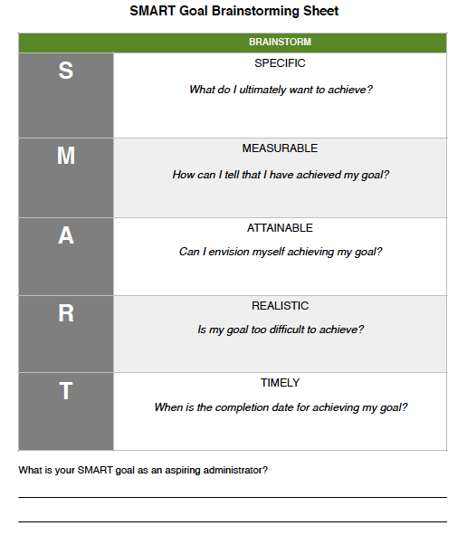
SMART Goal Setting
Example:
By July 2019, I will complete all courses toward my Master’s degree in Educational Leadership at Barry University, pass the FELE, and fulfill all entry requirements for the Aspiring Leaders Academy-1 to be an Assistant Principal.

Slide 4
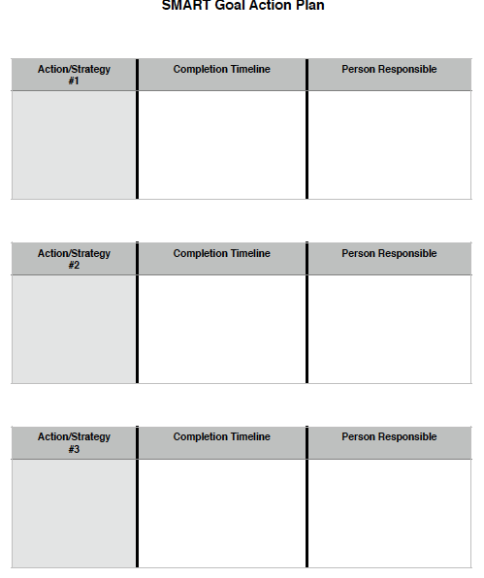
SMART Action Plan
Brainstorm:
Action/Strategy
Completion Timeline
Person Responsible

Slide 5
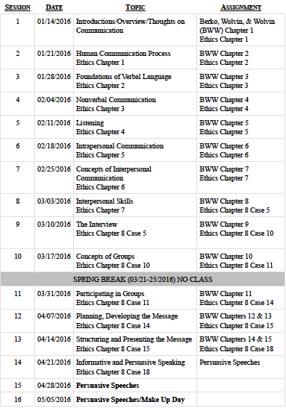
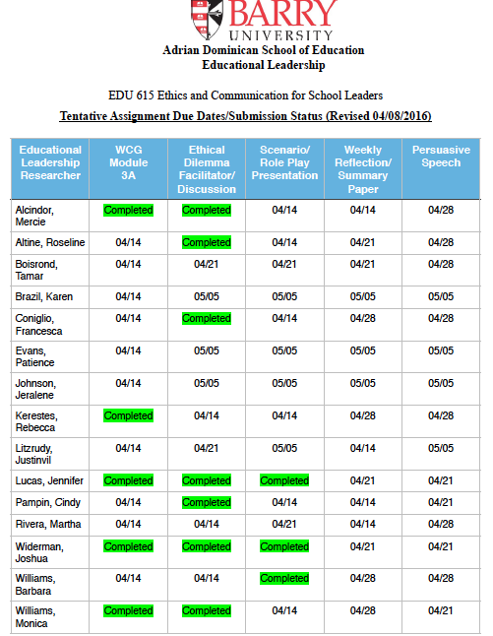

Slide 6
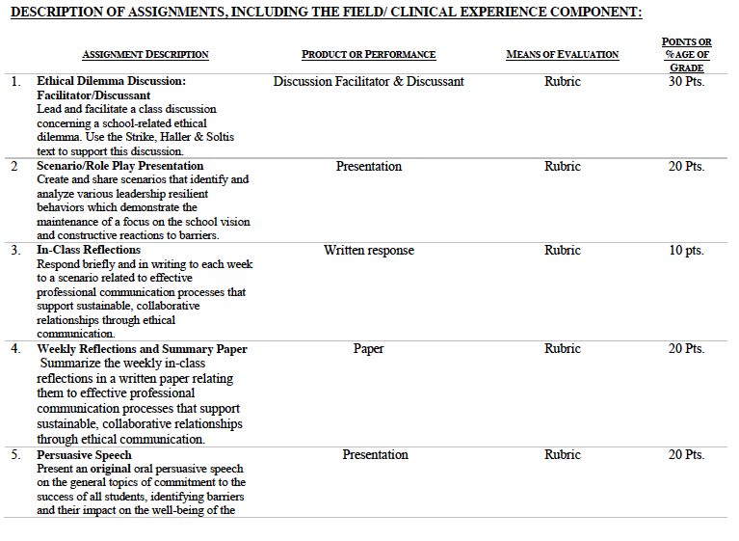

Slide 7
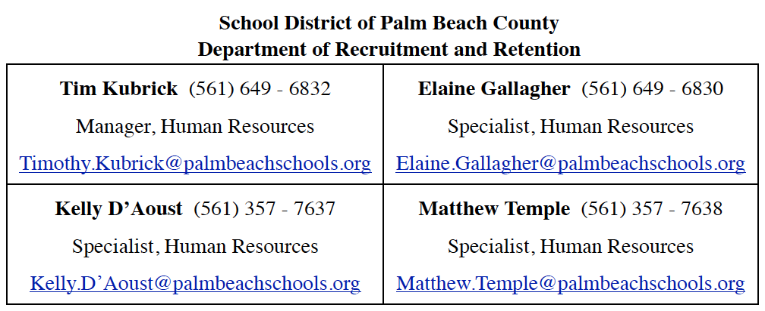
Consider the ethical implications
Former Palm Beach County HR employee admits to sex acts at work
April 6, 2016
[Name withheld]
http://cbs.com/news/local/former-palm-beach-county-hr-employee-admits-to-sex-acts-at-work
http://www.palmbeachschools.jobs/index.asp

Slide 8

Unpacking the Florida Principal Leadership Standards
The State of FL Principal Leadership Standards addressed:
Domain 1: Student Achievement
Standard 1: Student Learning Results
Effective school leaders achieve results on the school’s
student learning goals.
Domain 4: Professional and Ethical Behaviors
Standard 10: Professional and Ethical Behaviors
Effective school leaders demonstrate personal and
professional behaviors consistent with quality practices in
education and as a community leader.

Slide 9
Leadership Clock Buddies
Purpose:
To support collaborative educational leadership researcher pairs for effective leadership communication.
Instructions:
Book an appointment with 12 different educational leadership researchers (one for each hour of the leadership clock).
Ensure that you both record the appointment on the leadership clocks.
Book the appointment if there is a vacant slot at the hour for both of your leadership clocks.
Terrence’s Leadership Clock EDU 615
Roseline

Slide 10
Chapters 12 & 13:
Public speaking:
Developing and structuring the message (pp. 319-368)
Evaluate the validity of research material used to develop a speech.
Analyze the role of support material in the development of a speech.
Identify and evaluate means of presenting and focusing support material.
Explain why it is important to structure speeches carefully.
Explain how to structure a speech to meet the needs of the listeners.
Analyze and apply what makes an effective introduction, central idea, body, and conclusion for a speech.
Explain the purpose of a central idea of a speech and how to develop it.
Identify and illustrate the methods for the overall organization of a speech.
List and give examples of the methods for concluding a speech.
How do you make transitions into a question-and-answer session?

Slide 11
Chapter 8: Supplemental Cases
Case #15: Loyalty (pp.182)
Turn and Talk
What would you do if you were Nancy?
Is loyalty a moral virtue or just a personal disposition?
Are contracts made to be broken?
Doesn't an individual have a right to advance his or her own career?

Slide 12

STAR Targeted Selection Interviewing
Elements of the STAR:
S/T - Situation/Task That You Faced
Example: Describe a situation…
A - Actions That You Took
Example: What steps did you do in the situation?
R - Results or changes caused by these actions
Example: What were the results?

Slide 13
STAR Targeted Selection Interviewing
RATING SCALE
1 | Much less than acceptable
2 | Less than acceptable
3 | Acceptable
4 | More than acceptable
5 | Much more than acceptable

Slide 14
Scenario/Role Play (20 points)
Create and share scenarios that identify and analyze various leadership resilient behaviors which demonstrate the maintenance of a focus on the school vision and constructive reactions to barriers.
Ethical Dilemma Discussion Facilitator/Discussant (30 points)
Lead and facilitate a class discussion concerning a school-related ethical dilemma using supporting details from the text.
Admin Team 1
Mercie
Roseline
Tamar
Karen
Francesca
Admin Team 2
Patience
Jeralene
Rebecca
Jennifer
Cindy
Admin Team 3
Monica
Joshua
Martha
Barbara
Litzrudy

Slide 15

In-Class Reflection
Respond briefly and in writing each week to a scenario related to effective professional communication processes that support sustainable, collaborative relationships through ethical communication.
You may use the scenario in the assigned textbook chapter or one that was discussed in class.
The length should be at least one full page, typed, double spaced, Times New Roman font size 12.
Must have a cover page and reference page(s).
Use APA format (refer to the APA manual and page 9 of the syllabus).
Refer to the Written In-Class Assignment Rubric in page 19 of the syllabus.
Bring a copy to class for discussion.

Slide 16
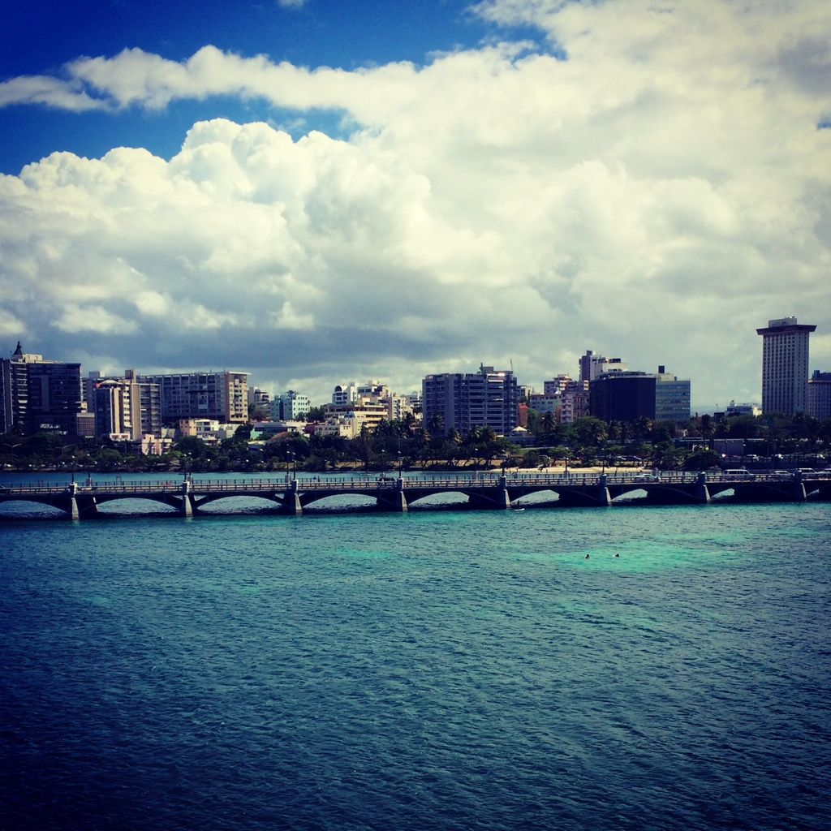
Weekly Reflections and Summary Paper (ongoing)
Summarize the weekly in-class reflections in a written paper relating them to effective professional communication processes that support sustainable, collaborative relationships through ethical communication.
Double spaced, Times New Roman, font size 12.
Must have a cover page and reference page(s).
Use APA format (refer the APA manual and page 9 of the syllabus).
Bring a copy to class for discussion.

Slide 17
Embedded Scenario/Role Play Presentation Collaboration
Create and share scenarios that identify and analyze various leadership resilient behaviors which demonstrate the maintenance of a focus on the school vision and constructive reactions to barriers.
Relevant Scenario
Develop Storyboard
Assign Roles
Act Your Role
Debrief
Identify the Problem Find a Solution

Slide 18
In-Basket Activity
If you have a GREEN folder with your course syllabus, your role in the activity is an elementary School Principal. You can select ONE Assistant Principal with a RED or ORANGE folder.
If you have a BLUE folder, you are a middle or high School Principal. You can select up to 3 Assistant Principals with a RED or ORANGE folder.
ELEMENTARY PRINCIPAL
MIDDLE/HIGH PRINCIPAL

Slide 19
In-Basket Activity
Using the Code of Ethics of the Education Profession in Florida and the Florida Principal Leadership Standards, examine the assigned scenario.
1. What possible issues/concerns might this scenario raise?
2. How could this situation become a violation of the law, the “Code” or other school/district policies?
3. In this situation, what are some potential negative consequences for the teacher/administrator, for the students and the school community?
4. What responses/actions will result in a more positive outcome and/or what proactive measures might be considered?
Principals, be ready to share out in 10 minutes!

Slide 20
Wrap Up
Review
Next week assignments:
Readings - BWW Chapter 14 & 15, Ethics Chapter 8 (Case 18)
Preparation for Scenario/Role Play Presentation (refer to the Communication rubric on the EDU 615 syllabus)
Preparation for the Ethical Dilemma
Preparation for Persuasive Speech

Slide 21
References
APA (2010). Publication manual of the American Psychological Association (6th ed.). Washington, DC: American Psychological Association.
Berko, R., Wolvin, A., & Wolvin, D. & Aitken, J. (2012). Public speaking: developing, structuring the message. In K. Bowers & M. Mashburn (Eds.),
Communicating: A social, cultural and career focus (12th ed.) (pp. 343-368). Boston, MA: Pearson.
Bucyzner, M. (2016, April). Former Palm Beach County HR employee admits to sex acts at work. CBS12. Retrieved from http://cbs.com/news/local/
former-palm-beach-county-hr-employee-admits-to-sex-acts-at-work
Florida School Leaders. (2016, January). The William Cecil Golden school leadership development program. Retrieved from the Florida Department of
Education website http://www.floridaschoolleaders.org
Jobs. (n.d.). Retrieved April 8, 2016, from http: //www.palmbeachschools.org/jobs/index.asp
Strike, K.A., Haller, E.J. & Soltis, J.F. (2005). Supplemental cases. In K.A. Strike (Ed.), The ethics of school administration (3rd ed.) (pp. 182). New York,
NY: Teachers College.

