Slide 1


EDU 615
Ethics and Communication for Leaders
Week #2: Thursday, January 21, 2016
Terrence narinesingh, ed.s.
adjunct professor
Adrian Dominican school of education
educational leadership

Slide 2

Agenda
Review of the Florida Principal Leadership Standards
Leadership Clock Buddies Activity
Berko, R., Wolvin, A., & Wolvin, D. & Aitken, J. (2012). The human communication process.
    In K. Bowers & M. Mashburn (Eds.), Communicating: A social, cultural and career focus
    (12th ed.) (pp. 1-33). Boston, MA: Pearson.
Strike, K.A., Haller, E.J. & Soltis, J.E. (2005). Administration and Ethical Thinking. In K.A. Strike (Ed.),
  The ethics of school administration (3rd ed.) (pp. 1-6) New York, NY: Teachers College.
In-Class Reflection (Ongoing)
Weekly Reflections and Summary Paper (Ongoing)
Remind App
Problem-based Learning using the Florida Principal Leadership Standards
Next Week: Communications Chapter 2/Ethics Chapter 2
  In-Class Reflection and Summary Paper (Ongoing)

Slide 3
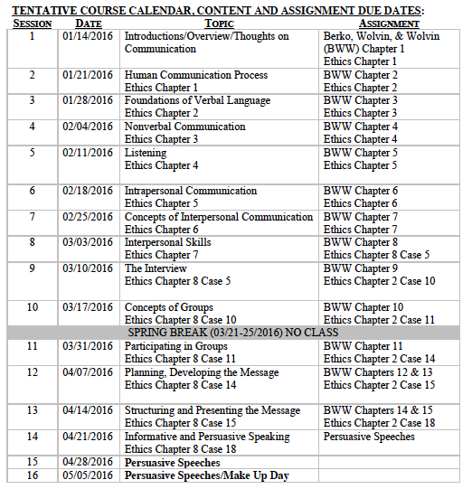
Tentative Course

Slide 4
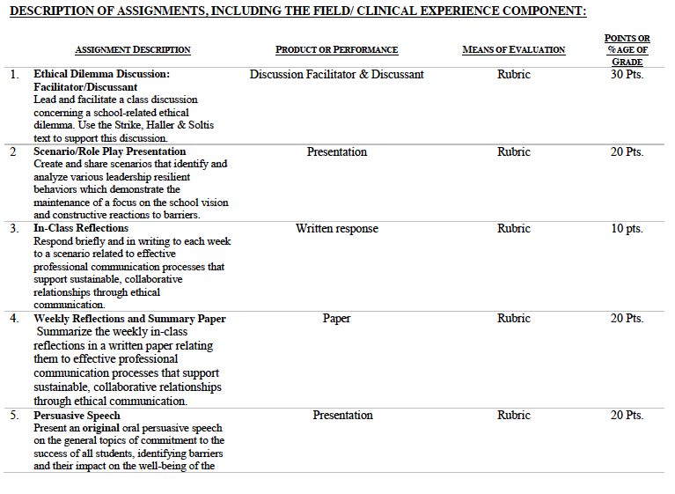

Slide 5
Unpacking the Florida Principal Leadership Standards
The State of FL Principal Leadership Standards addressed:
  Domain 1: Student Achievement
          Standard 1: Student Learning Results
          Effective school leaders achieve results on the school’s
          student learning goals.
  Domain 4: Professional and Ethical Behaviors
          Standard 10: Professional and Ethical Behaviors
          Effective school leaders demonstrate personal and
          professional behaviors consistent with quality practices in
          education and as a community leader.

Slide 6
Leadership Clock Buddies
Purpose:
To support collaborative educational leadership researcher pairs for effective leadership communication.
Instructions:
Book an appointment with 12 different educational leadership researchers (one for each hour of the leadership clock).
Ensure that you both record the appointment on the leadership clocks.
Book the appointment if there is a vacant slot at the hour for both of your leadership clocks.
Tamar
Karen
Josh
Jennifer
Martha
Terrence’s Leadership Clock EDU 615
Mercie
Cindy
Francesca
Patience
Barbara
Ann
Tiffany

Slide 7
Chapter 1: The Human Communication Process
List and explain the components of human communication.
Explain the effects of perceptions on the human communication process.
Identify, define and give examples of the noise factors that affect the human communication process.
Illustrate, define, and give examples of the linear, interactional, and transactional models of communication.
Describe the concept of communication as a system.
Explain the role of the media as a communicator.
Give evidence of the relationship between communication and culture.
Define and explain ethnocentrism.
Give an example of the role of First Amendment speech as a rhetorical tool.
Explain the role of the ethical value system in communication.
Analyze the basis for ethical communication.

Slide 8
Chapter 1:
Administration and Ethical Thinking
Turn and Talk
What made the administrative problem a moral ethical dilemma?
Differentiate between the two moral principles that are in play.
Reflect on your moral sentiments. Is there a conflict? How do we distinguish moral from nonmoral claims? Can we construct a general ethical theory that orders our ethical principles under some general view of the Good Life?

Slide 9
In-Class Reflection (ongoing)
    Respond briefly and in writing each week to a scenario related to effective professional communication processes that support sustainable, collaborative relationships through ethical communication.
    You may use the scenario in the assigned textbook chapter or one that was discussed in class.
    Typed, double spaced, Times New Roman font size 12.
    Must have a cover page and reference page(s).
    Use APA format (refer to the APA manual and page 9 of the syllabus).
    Refer to the Written In-Class Assignment Rubric in page 19 of the syllabus.
    Bring a copy to class for discussion.

Slide 10
Weekly Reflections and Summary Paper (ongoing)
    Summarize the weekly in-class reflections in a written paper relating them to effective professional communication processes that support sustainable, collaborative relationships through ethical communication.
    Typed, double spaced, Times New Roman, font size 12.
    Must have a cover page and reference page(s).
    Use APA format (refer the APA manual and page 9 of the syllabus).
    Bring a copy to class for discussion.

Slide 11
Remind
App
Enter this number
81010
Text this message
@ethicsandc

Slide 12
Individual Activity:
William Cecil Golden (WCG) School Leadership Development Program
Register for the WCG.
Take the self-assessment.
Determine your strengths and areas of growth in the WCG.
Documentation for completion modules and work for the 10 Principal Leadership Standards.
Website: www.FloridaSchoolLeaders.org

Slide 13
In-Basket Activity
If you have a GREEN folder with your course syllabus, your role in the activity is an elementary School Principal. You can select ONE Assistant Principal with a RED or ORANGE folder.
If you have a BLUE folder, you are a middle or high School Principal. You can select up to 3 Assistant Principals with a RED or ORANGE folder.
ELEMENTARY PRINCIPAL
MIDDLE/HIGH PRINCIPAL

Slide 14
In-Basket Activity
Using the Code of Ethics of the Education Profession in Florida and the Florida Principal Leadership Standards, examine the assigned scenario.
1. What possible issues/concerns might this scenario raise?
2. How could this situation become a violation of the law, the “Code” or other school/district policies?
3. In this situation, what are some potential negative consequences for the teacher/administrator, for the students and the school community?
4. What responses/actions will result in a more positive outcome and/or what proactive measures might be considered?
Principals, be ready to share out in 10 minutes!

Slide 15
Consider the ethical implications
Florida Principal Who Smoked Pot With Student Resigned From Previous School During Investigation
May 12, 2015
Krista Morton, Principal, Mavericks High School
http://www.nydailynews.com/news/national/florida-principal-smoked-student-prior-scandal-article-1.2218904

Slide 16
Wrap Up
Review
Readings - BWW Chapter 2, Ethics Chapter 2
Next week:
  Work in progress (bring for formative feedback)
      In-Class Reflection
      Weekly Reflections and Summary Paper

Slide 17
References
APA (2010). Publication manual of the American Psychological Association
  (6th ed.). Washington, DC: American Psychological Association.
Berko, R., Wolvin, A., & Wolvin, D. & Aitken, J. (2012). The human communication process.
  In K. Bowers & M. Mashburn (Eds.), Communicating: A social, cultural and career focus (12th ed.) (pp. 1-33). Boston, MA: Pearson.
Florida School Leaders. (2016, January). The William Cecil Golden school leadership development
  program. Retrieved from the Florida Department of Education website https://www.floridaschoolleaders.org/
Silverstein, J. (2015). Florida principal who smoked pot with student resigned from previous school during
  investigation. New York Daily News. Retrieved from http://www.nydailynews.com/news/national/florida-principal-smoked-student-prior-scandal-article-1.2218904
Strike, K.A., Haller, E.J. & Soltis, J.E. (2005). Administration and Ethical Thinking. In K.A. Strike
  (Ed.), The ethics of school administration (3rd ed.) (pp. 1-6) New York, NY: Teachers College.

