Slide 1


EDU 615
Ethics and Communication for Leaders
Week #3: Thursday, January 28, 2016
Terrence narinesingh, ed.s.
adjunct professor
Adrian Dominican school of education
educational leadership

Slide 2

Agenda
Moral Imperative Video and Discussion
Unpacking the Florida Principal Leadership Standards
Leadership Clock Buddies Activity
Berko, R., Wolvin, A., & Wolvin, D. & Aitken, J. (2012). Foundations of verbal language.
In K. Bowers & M. Mashburn (Eds.), Communicating: A social, cultural and career focus
(12th ed.) (pp. 34-51). Boston, MA: Pearson.
Strike, K.A., Haller, E.J. & Soltis, J.E. (2005). Intellectual liberty. In K.A. Strike (Ed.),
The ethics of school administration (3rd ed.) (pp. 7-29). New York, NY: Teachers College.
In-Class Reflection
Weekly Reflections and Summary Paper
FSA App
WCG Module: The Ethical Educator
Problem-based Learning using the Florida Principal Leadership Standards
Next Week: Ongoing readings and discussion

Slide 3
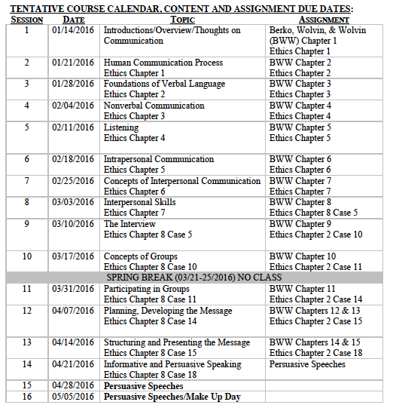
Tentative Course

Slide 4
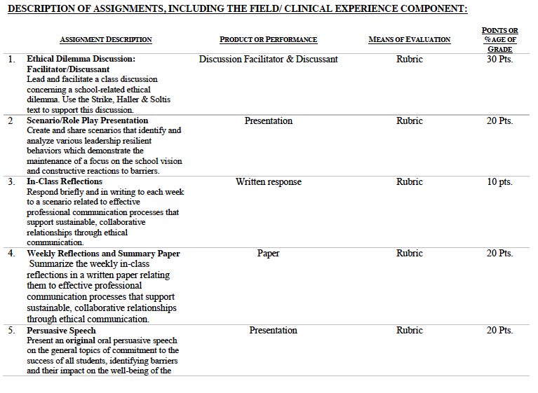

Slide 5

Is there a moral imperative?
Think about the moral imperative as you watch the clip.
Susan Jordan, Principal
www.cnn.com/2016/01/26/us/indiana-school-bus/index.html

Slide 6
Unpacking the Florida Principal Leadership Standards
The State of FL Principal Leadership Standards addressed:
Domain 1: Student Achievement
Standard 1: Student Learning Results
Effective school leaders achieve results on the school’s
student learning goals.
Domain 4: Professional and Ethical Behaviors
Standard 10: Professional and Ethical Behaviors
Effective school leaders demonstrate personal and
professional behaviors consistent with quality practices in
education and as a community leader.

Slide 7
Leadership Clock Buddies
Purpose:
To support collaborative educational leadership researcher pairs for effective leadership communication.
Instructions:
Book an appointment with 12 different educational leadership researchers (one for each hour of the leadership clock).
Ensure that you both record the appointment on the leadership clocks.
Book the appointment if there is a vacant slot at the hour for both of your leadership clocks.
Tamar
Karen
Josh
Jennifer
Martha
Terrence’s Leadership Clock EDU 615
Mercie
Cindy
Francesca
Patience
Barbara
Ann
Tiffany

Slide 8
Chapter 2: Foundations of verbal language
Name and describe several theories of the origin of human language.
Analyze how thought is shaped by language.
Explain and illustrate how people select, process, use, and learn symbols.
Identify the features common to all languages.
Define and illustrate the emotive, phatic, cognitive, rhetorical, and identifying functions of language.
Explain the roles of ambiguity, vagueness, inference, and message adjustment in relation to language distortion.
Define and contrast standard versus nonstandard dialects, and relate the effects of speaking a nonstandard dialect.
Analyze slang as it relates to standard dialects.
Explain Standard American English.
Describe the effects of using verbal language.

Slide 9
Chapter 2:
Intellectual liberty
Turn and Talk
Is there an intellectual freedom issue?
Differentiate between the two moral principles that are in play: the Principle of Benefit Maximization and the Principle of Equal Respect.
Reflect on your moral sentiments. Are there times when it appears that if we follow the logic of the Principle of Benefit Maximization that we must violate the Principle of Equal Respect and vice versa?

Slide 10
In-Class Reflection (ongoing)
Respond briefly and in writing each week to a scenario related to effective professional communication processes that support sustainable, collaborative relationships through ethical communication.
You may use the scenario in the assigned textbook chapter or one that was discussed in class.
The length should be at least one full page, typed, double spaced, Times New Roman font size 12.
Must have a cover page and reference page(s).
Use APA format (refer to the APA manual and page 9 of the syllabus).
Refer to the Written In-Class Assignment Rubric in page 19 of the syllabus.
Bring a copy to class for discussion.

Slide 11
Weekly Reflections and Summary Paper (ongoing)
Summarize the weekly in-class reflections in a written paper relating them to effective professional communication processes that support sustainable, collaborative relationships through ethical communication.
Double spaced, Times New Roman, font size 12.
Must have a cover page and reference page(s).
Use APA format (refer the APA manual and page 9 of the syllabus).
Bring a copy to class for discussion.

Slide 12


Florida College
and Career
Ready
Standards

Slide 13
Individual Activity:
William Cecil Golden (WCG) School Leadership Development Program
Register for the WCG.
Take the self-assessment.
Determine your strengths and areas of growth in the WCG.
Complete the WCG Module: The Ethical Educator Chapter 3, WBA 3A
Website: www.FloridaSchoolLeaders.org

Slide 14
In-Basket Activity
If you have a GREEN folder with your course syllabus, your role in the activity is an elementary School Principal. You can select ONE Assistant Principal with a RED or ORANGE folder.
If you have a BLUE folder, you are a middle or high School Principal. You can select up to 3 Assistant Principals with a RED or ORANGE folder.
ELEMENTARY PRINCIPAL
MIDDLE/HIGH PRINCIPAL

Slide 15
In-Basket Activity
Using the Code of Ethics of the Education Profession in Florida and the Florida Principal Leadership Standards, examine the assigned scenario.
1. What possible issues/concerns might this scenario raise?
2. How could this situation become a violation of the law, the “Code” or other school/district policies?
3. In this situation, what are some potential negative consequences for the teacher/administrator, for the students and the school community?
4. What responses/actions will result in a more positive outcome and/or what proactive measures might be considered?
Principals, be ready to share out in 10 minutes!

Slide 16
Wrap Up
Review
Next week Assignments:
In-Class Reflection
Weekly Reflections and Summary Paper
Readings - BWW Chapter 4, Ethics Chapter 4

Slide 17
References
APA (2010). Publication manual of the American Psychological Association
(6th ed.). Washington, DC: American Psychological Association.
Berko, R., Wolvin, A., & Wolvin, D. & Aitken, J. (2012). Foundations of verbal language. In K.
Bowers & M. Mashburn (Eds.), Communicating: A social, cultural and career focus
(12th ed.) (pp. 34-51). Boston, MA: Pearson.
Payne, E. & Ford, D. (2016). Principal pushed children out of the way before being killed by bus in
Indiana. CNN. Retrieved from http://www.cnn.com/2016/01/26/us/indiana-school-bus/
index.html
Strike, K.A., Haller, E.J. & Soltis, J.E. (2005). Intellectual liberty. In K.A. Strike (Ed.),
The ethics of school administration (3rd ed.) (pp. 7-29). New York, NY: Teachers College.

