Slide 1


EDU 615
Ethics and Communication for Leaders
Week #4: Thursday, February 4, 2016
Terrence narinesingh, ed.s.
adjunct professor
Adrian Dominican school of education
educational leadership

Slide 2

Agenda
Welcome
Tentative Course Calendar and Assignment
Moral Imperative Video and Discussion
Unpacking the Florida Principal Leadership Standards
Leadership Clock Buddies Activity
Berko, R., Wolvin, A., & Wolvin, D. & Aitken, J. (2012). Nonverbal communication.
    In K. Bowers & M. Mashburn (Eds.), Communicating: A social, cultural and career focus
    (12th ed.) (pp. 52-79). Boston, MA: Pearson.
Strike, K.A., Haller, E.J. & Soltis, J.E. (2005). Individual freedom and the public interest. In K.A. Strike (Ed.),
  The ethics of school administration (3rd ed.) (pp. 30-51). New York, NY: Teachers College.
In-Class Reflection and Weekly Reflections and Summary Paper
WCG Module: The Ethical Educator
Problem-based Learning using the Florida Principal Leadership Standards
Next Week: Ongoing readings and discussion

Slide 3
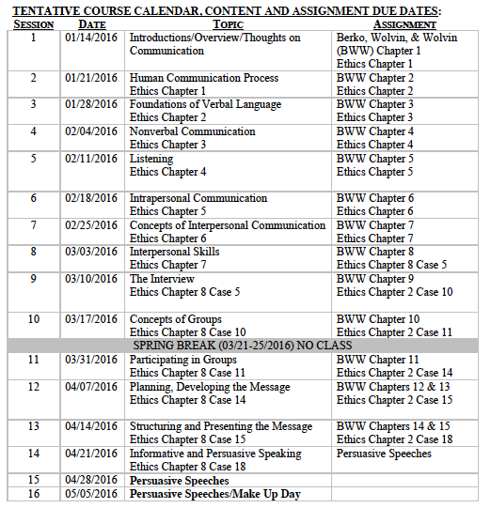
Tentative Course

Slide 4
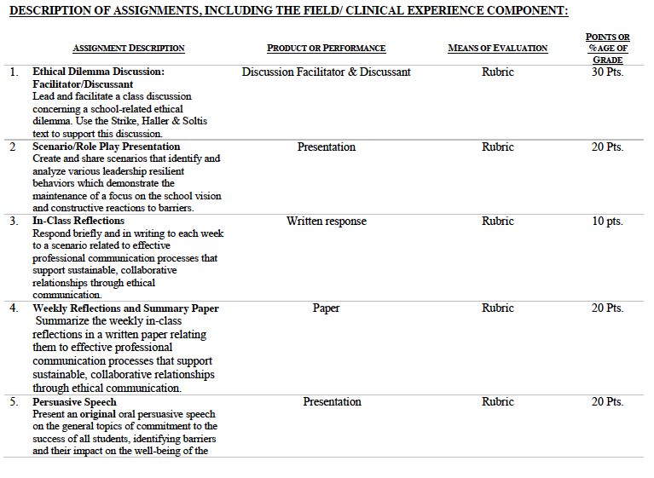

Slide 5
Is there a moral imperative?
Miami-Dade Schools Remove Principal After His Post About Police Controversy
June 9, 2015
Alberto Iber, North Miami Senior High School
http://www.miamiherald.com/news/local/education/article23616994.html

Slide 6

Unpacking the Florida Principal Leadership Standards
The State of FL Principal Leadership Standards addressed:
  Domain 1: Student Achievement
            Standard 1: Student Learning Results
            Effective school leaders achieve results on the school’s
            student learning goals.
  Domain 4: Professional and Ethical Behaviors
            Standard 10: Professional and Ethical Behaviors
            Effective school leaders demonstrate personal and
            professional behaviors consistent with quality practices in
            education and as a community leader.

Slide 7
Leadership Clock Buddies
Purpose:
To support collaborative educational leadership researcher pairs for effective leadership communication.
Instructions:
Book an appointment with 12 different educational leadership researchers (one for each hour of the leadership clock).
Ensure that you both record the appointment on the leadership clocks.
Book the appointment if there is a vacant slot at the hour for both of your leadership clocks.
Tamar
Karen
Josh
Jennifer
Martha
Terrence’s Leadership Clock EDU 615
Mercie
Cindy
Francesca
Patience
Barbara
Ann
Tiffany

Slide 8
Chapter 3: Nonverbal communication
Explain the importance of nonverbal communication as a message-sending system.
Categorize and discuss the origins of nonverbal messages.
State and evaluate the relationship between verbal and nonverbal communication.
List and illustrate the categories of nonverbal communication.
Analyze the role of culture in the development and use of nonverbal communication.

Slide 9
Chapter 3:
Individual freedom and the public interest
Turn and Talk
Debate whether Ms. Loring’s job as a topless dancer is considered a public or private action.
Is there a double standard?
Discuss the Principle of Gender Equity and the impact of Ms. Loring’s second job on her students.
Apply the Principles of Benefit Maximization and Equal Respect to the concept of individual liberty.

Slide 10
Is there a moral imperative?
Tracy Wayne Shealy: Royal Palm Beach High School Assistant Principal Prostitution Arrest
June 8, 2013
http://www.wptv.com/news/region-c-palm-beach-county/lake-worth/tracy-wayne-shealy-royal-palm-beach-high-school-assistant-principal-prostitution-arrest

Slide 11

In-Class Reflection (ongoing)
    Respond briefly and in writing each week to a scenario related to effective professional communication processes that support sustainable, collaborative relationships through ethical communication.
    You may use the scenario in the assigned textbook chapter or one that was discussed in class.
    The length should be at least one full page, typed, double spaced, Times New Roman font size 12.
    Must have a cover page and reference page(s).
    Use APA format (refer to the APA manual and page 9 of the syllabus).
    Refer to the Written In-Class Assignment Rubric in page 19 of the syllabus.
    Bring a copy to class for discussion.

Slide 12
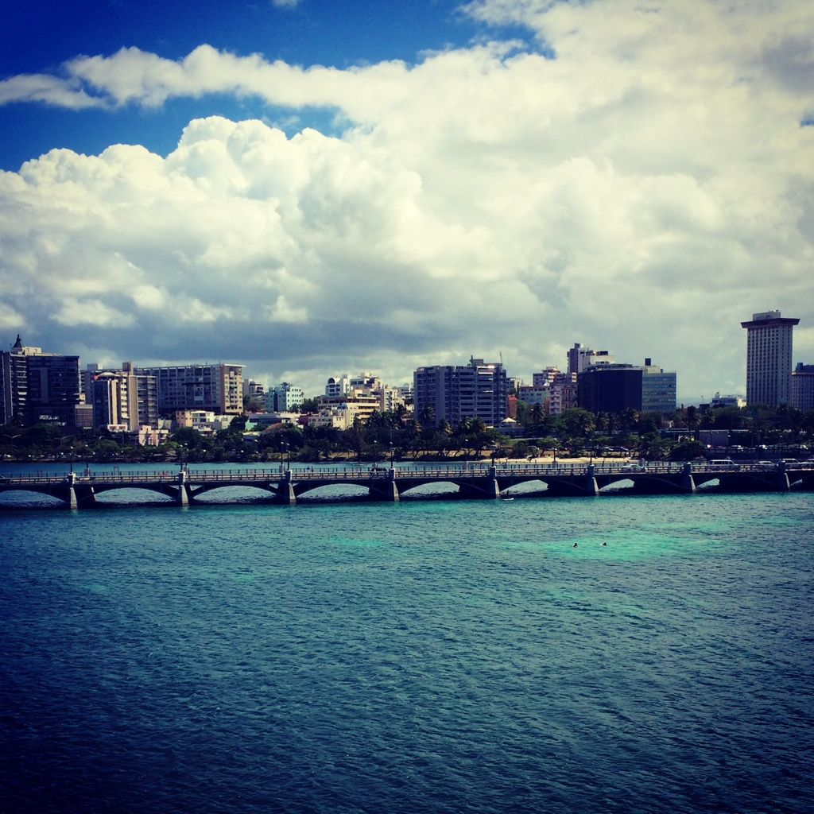
Weekly Reflections and Summary Paper (ongoing)
    Summarize the weekly in-class reflections in a written paper relating them to effective professional communication processes that support sustainable, collaborative relationships through ethical communication.
    Double spaced, Times New Roman, font size 12.
    Must have a cover page and reference page(s).
    Use APA format (refer the APA manual and page 9 of the syllabus).
    Bring a copy to class for discussion.

Slide 13
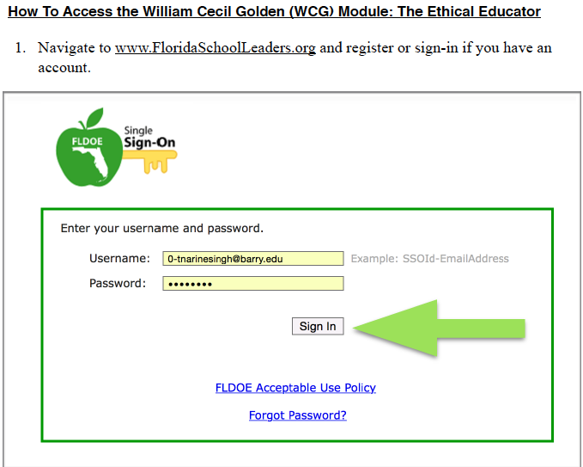

Slide 14
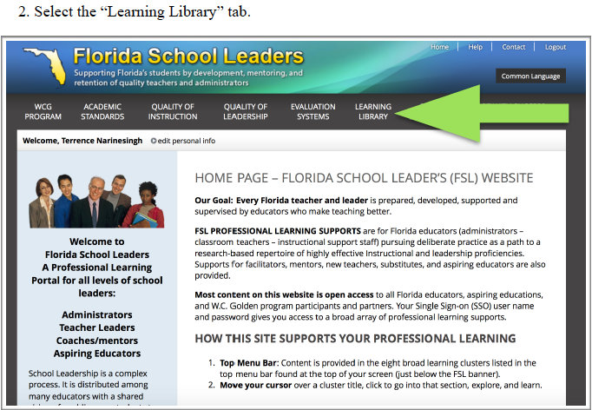

Slide 15


Slide 16
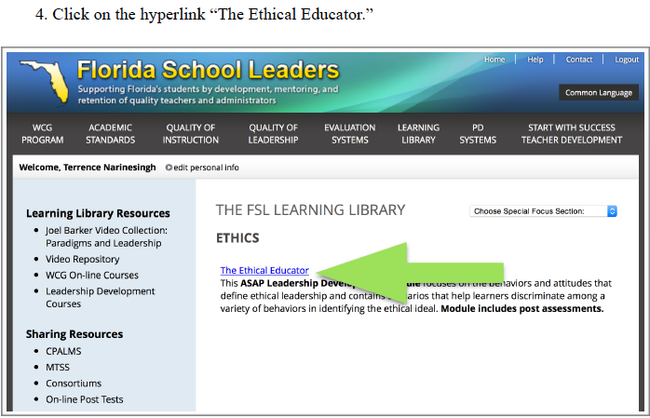

Slide 17
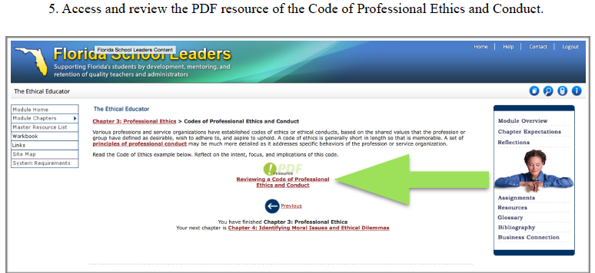

Slide 18
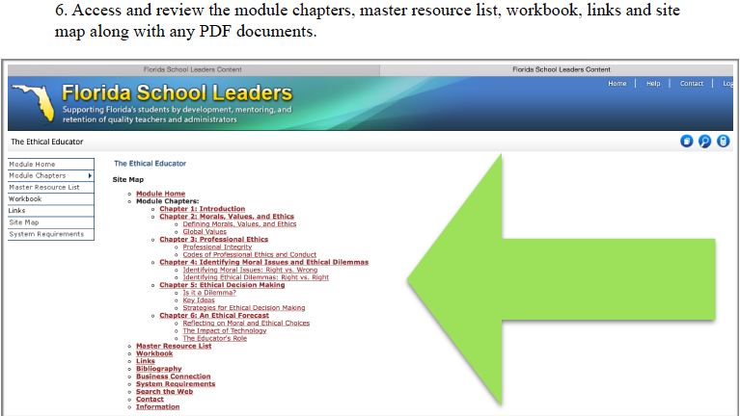

Slide 19
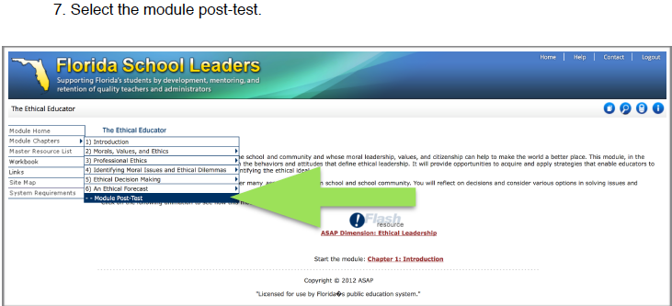

Slide 20
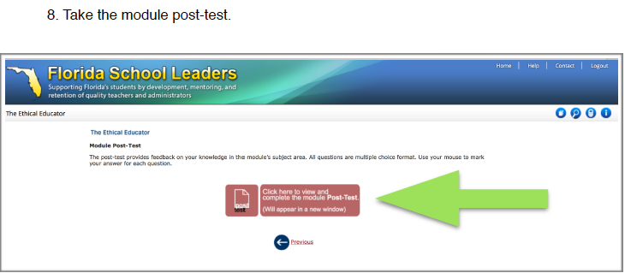

Slide 21
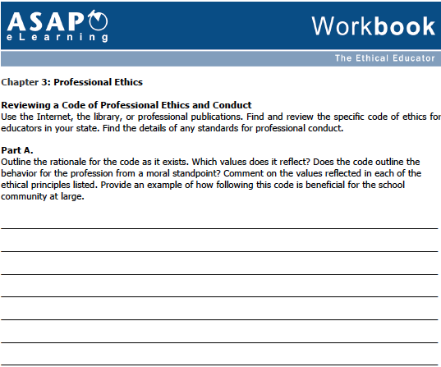

Slide 22
In-Basket Activity
If you have a GREEN folder with your course syllabus, your role in the activity is an elementary School Principal. You can select ONE Assistant Principal with a RED or ORANGE folder.
If you have a BLUE folder, you are a middle or high School Principal. You can select up to 3 Assistant Principals with a RED or ORANGE folder.
ELEMENTARY PRINCIPAL
MIDDLE/HIGH PRINCIPAL

Slide 23
In-Basket Activity
Using the Code of Ethics of the Education Profession in Florida and the Florida Principal Leadership Standards, examine the assigned scenario.
1. What possible issues/concerns might this scenario raise?
2. How could this situation become a violation of the law, the “Code” or other school/district policies?
3. In this situation, what are some potential negative consequences for the teacher/administrator, for the students and the school community?
4. What responses/actions will result in a more positive outcome and/or what proactive measures might be considered?
Principals, be ready to share out in 10 minutes!

Slide 24
Wrap Up
Review
Next week Assignments:
      In-Class Reflection
      Weekly Reflections and Summary Paper
      Readings - BWW Chapter 4, Ethics Chapter 4

Slide 25
References
APA (2010). Publication manual of the American Psychological Association (6th ed.). Washington, DC: American Psychological
  Association.
Berko, R., Wolvin, A., & Wolvin, D. & Aitken, J. (2012). Nonverbal communication. In K. Bowers & M. Mashburn (Eds.),
  Communicating: A social, cultural and career focus (12th ed.) (pp. 52-79). Boston, MA: Pearson.
Florida School Leaders. (2016, January). The William Cecil Golden school leadership development program. Retrieved from the
  Florida Department of Education website https://www.floridaschoolleaders.org/
Strike, K.A., Haller, E.J. & Soltis, J.E. (2005). Individual freedom and the public interest. In K.A. Strike (Ed.),
  The ethics of school administration (3rd ed.) (pp. 30-51). New York, NY: Teachers College.
Veiga, C. (2015). Miami-Dade schools remove principal after his post about police controversy. Miami Herald. Retrieved from
  http://www.miamiherald.com/news/local/education/article23616994.html
WPTV Web Team. (2013). Tracy Wayne Shealy: Royal Palm Beach High School assistant principal prostitution arrest. WPTV.
  Retrieved from http://www.wptv.com/news/region-c-palm-beach-county/lake-worth/tracy-wayne-shealy-royal-palm-beach-high-school-assistant-principal-prostitution-arrest

