Slide 1


EDU 615
Ethics and Communication for Leaders
Week #5: Thursday, February 11, 2016
Terrence narinesingh, ed.s.
adjunct professor
Adrian Dominican school of education
educational leadership

Slide 2

Agenda
Welcome
Tentative Course Calendar and Assignment
Moral Imperative Video and Discussion
Unpacking the Florida Principal Leadership Standards
Leadership Clock Buddies Activity
Berko, R., Wolvin, A., & Wolvin, D. & Aitken, J. (2012). Listening.
    In K. Bowers & M. Mashburn (Eds.), Communicating: A social, cultural and career focus
    (12th ed.) (pp. 80-106). Boston, MA: Pearson.
Strike, K.A., Haller, E.J. & Soltis, J.E. (2005). Equal educational opportunity. In K.A. Strike (Ed.),
  The ethics of school administration (3rd ed.) (pp. 52-71). New York, NY: Teachers College.
In-Class Reflection and Weekly Reflections and Summary Paper
WCG Module: The Ethical Educator
Problem-based Learning using the Florida Principal Leadership Standards
Next Week: Ongoing readings and discussion

Slide 3
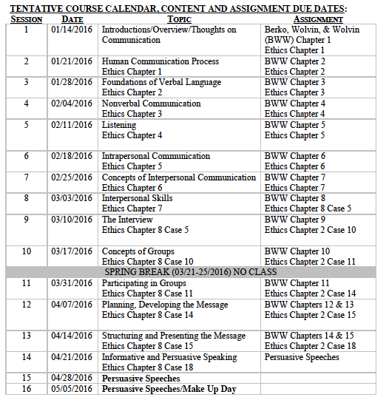
Tentative Course

Slide 4
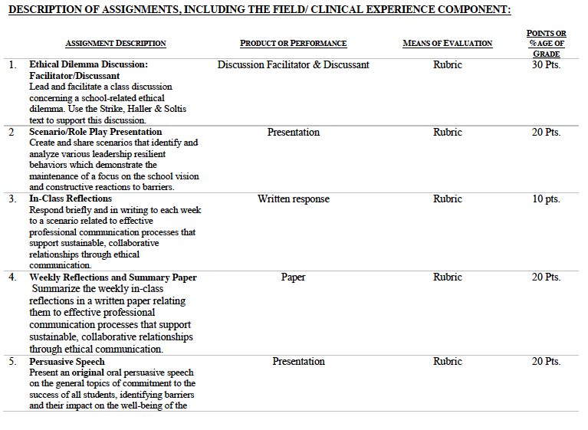

Slide 5
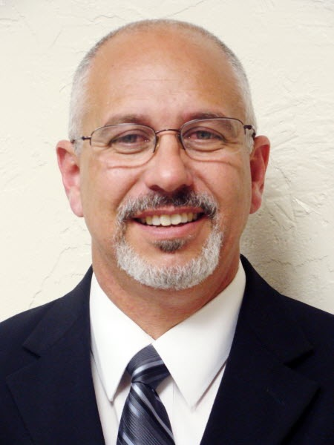
Consider the ethical implications
School Board Asked to Approve $75K Settlement Stemming From Sex Harassment Claims Against RPB Principal
October 1, 2013
http://www.palmbeachpost.com/news/news/local-education/school-board-asked-to-approve-75k-settlement-stemm/nbChF/

Slide 6

Unpacking the Florida Principal Leadership Standards
The State of FL Principal Leadership Standards addressed:
  Domain 1: Student Achievement
            Standard 1: Student Learning Results
            Effective school leaders achieve results on the school’s
            student learning goals.
  Domain 4: Professional and Ethical Behaviors
            Standard 10: Professional and Ethical Behaviors
            Effective school leaders demonstrate personal and
            professional behaviors consistent with quality practices in
            education and as a community leader.

Slide 7
Leadership Clock Buddies
Purpose:
To support collaborative educational leadership researcher pairs for effective leadership communication.
Instructions:
Book an appointment with 12 different educational leadership researchers (one for each hour of the leadership clock).
Ensure that you both record the appointment on the leadership clocks.
Book the appointment if there is a vacant slot at the hour for both of your leadership clocks.
Jennifer
Terrence’s Leadership Clock EDU 615
Barbara

Slide 8
Chapter 4: Listening
Explain the importance of listening in daily communication.
Contrast hearing and listening.
Define and identify the roles of reception, perception, attention, the assignment of meaning, and response as they relate to the listening process.
List and explain some of the listening influencers.
Describe discriminative, comprehensive, therapeutic, critical, and appreciative listening.

Slide 9
Chapter 4: Listening
6. Explain strategies for how to listen to the media.
7. Identify and explain some of the techniques available for improving personal listening.
8. Discuss the causes of listening apprehension and approaches to dealing with it.

Slide 10
Chapter 4:
Equal educational opportunity
Turn and Talk
Consider how each party involved in the dispute might argue for their view.
Apply the Principle of Equal Treatment to the dispensing of educational resources.
How can the Principle of Benefit Maximization conflict with the Principle of Equal Respect?

Slide 11
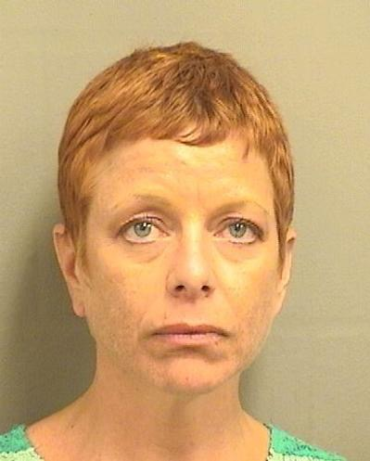
Consider the ethical implications
Schools May Settle Sex Harassment Complaint with Wellington Counselor
August 14, 2015
http://m.palmbeachpost.com/news/news/schools-may-settle-sex-harassment-complaint-with-w/nnKgm/
http://www.boarddocs.com/fl/palmbeach/Board.nsf/files/9ZD29U7488EA/$file/LD1%20Mazzocco%20Release.pdf

Slide 12

In-Class Reflection (ongoing)
    Respond briefly and in writing each week to a scenario related to effective professional communication processes that support sustainable, collaborative relationships through ethical communication.
    You may use the scenario in the assigned textbook chapter or one that was discussed in class.
    The length should be at least one full page, typed, double spaced, Times New Roman font size 12.
    Must have a cover page and reference page(s).
    Use APA format (refer to the APA manual and page 9 of the syllabus).
    Refer to the Written In-Class Assignment Rubric in page 19 of the syllabus.
    Bring a copy to class for discussion.

Slide 13

Weekly Reflections and Summary Paper (ongoing)
    Summarize the weekly in-class reflections in a written paper relating them to effective professional communication processes that support sustainable, collaborative relationships through ethical communication.
    Double spaced, Times New Roman, font size 12.
    Must have a cover page and reference page(s).
    Use APA format (refer the APA manual and page 9 of the syllabus).
    Bring a copy to class for discussion.

Slide 14
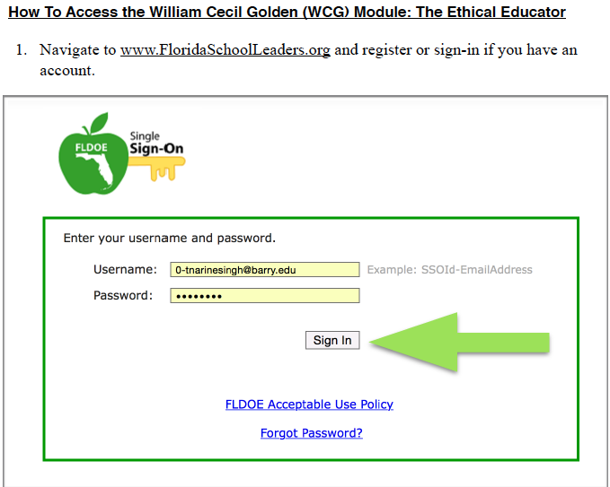

Slide 15
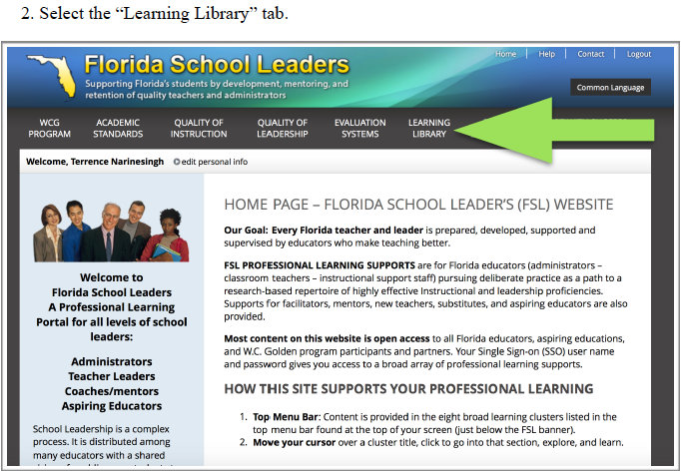

Slide 16
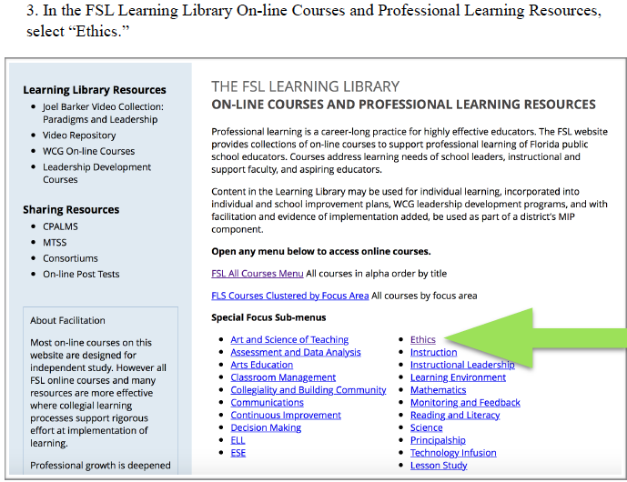

Slide 17
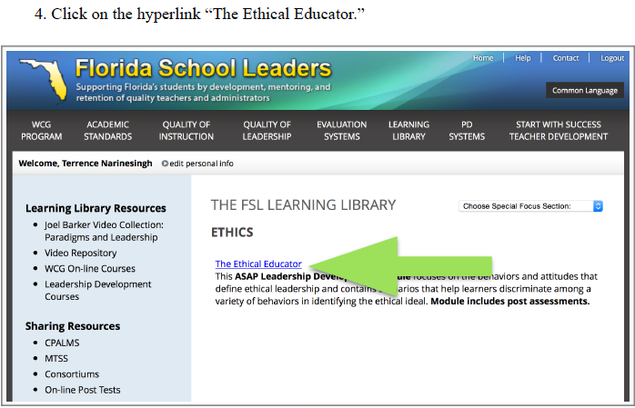

Slide 18
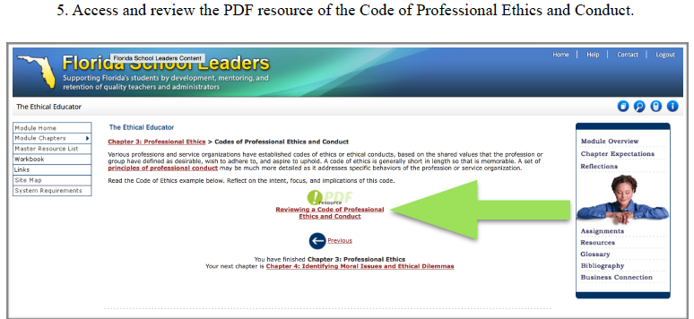

Slide 19
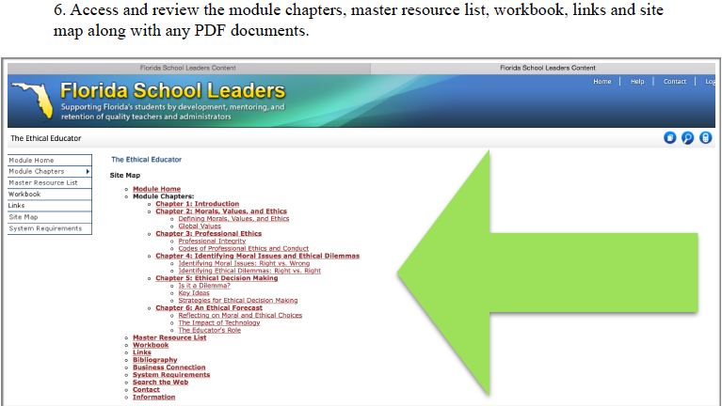

Slide 20
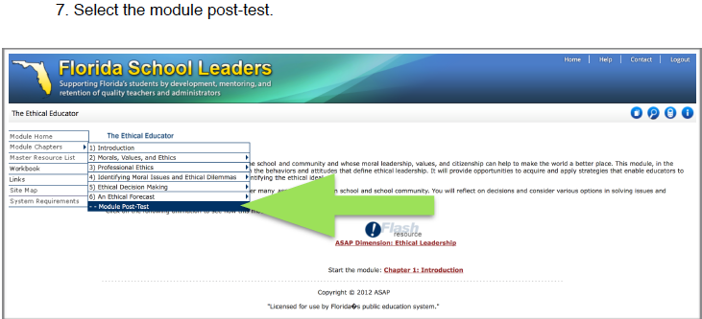

Slide 21
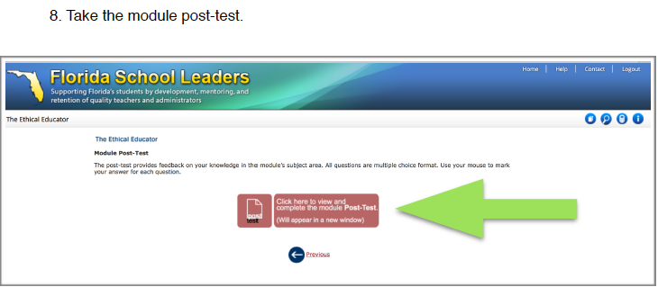

Slide 22
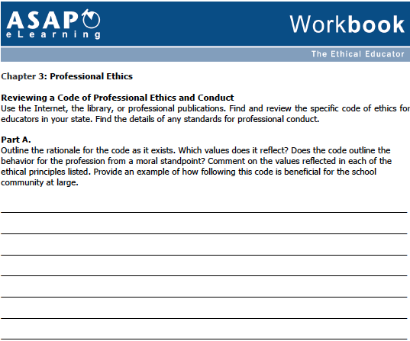

Slide 23
In-Basket Activity
If you have a GREEN folder with your course syllabus, your role in the activity is an elementary School Principal. You can select ONE Assistant Principal with a RED or ORANGE folder.
If you have a BLUE folder, you are a middle or high School Principal. You can select up to 3 Assistant Principals with a RED or ORANGE folder.
ELEMENTARY PRINCIPAL
MIDDLE/HIGH PRINCIPAL

Slide 24
In-Basket Activity
Using the Code of Ethics of the Education Profession in Florida and the Florida Principal Leadership Standards, examine the assigned scenario.
1. What possible issues/concerns might this scenario raise?
2. How could this situation become a violation of the law, the “Code” or other school/district policies?
3. In this situation, what are some potential negative consequences for the teacher/administrator, for the students and the school community?
4. What responses/actions will result in a more positive outcome and/or what proactive measures might be considered?
Principals, be ready to share out in 10 minutes!

Slide 25
Wrap Up
Review
Next week Assignments:
      In-Class Reflection
      Weekly Reflections and Summary Paper
      Readings - BWW Chapter 5, Ethics Chapter 5
      Preparation for Scenario/Role Play Presentation

Slide 26
References
APA (2010). Publication manual of the American Psychological Association (6th ed.). Washington, DC: American Psychological Association.
Berko, R., Wolvin, A., & Wolvin, D. & Aitken, J. (2012). Listening. In K. Bowers & M. Mashburn (Eds.),
  Communicating: A social, cultural and career focus (12th ed.) (pp. 80-106). Boston, MA: Pearson.
Florida School Leaders. (2016, January). The William Cecil Golden school leadership development program. Retrieved from the
  Florida Department of Education website https://www.floridaschoolleaders.org/
Marra, A. (2015). Schools may settle harassment complaint with Wellington counselor. Palm Beach Post. Retrieved from
  http://www.palmbeachpost.com/news/news/schools-may-settle-sex-harassment-complaint-with-w/nnKgm/
Palm Beach County School Board. (2015). BoardDocs: Release of all claims. Palm Beach County School District. Retrieved from
  http://www.boarddocs.com/fl/palmbeach/Board.nsf/files/9ZD29U7488EA/$file/LD1%20Mazzocco%20Release.pdf
Schultz, J. (2013). School board asked to approve $75K settlement stemming from sex harassment claims against RPB principal.
  Palm Beach Post. Retrieved from http://www.palmbeachpost.com/news/news/local-education/school-board-asked-to-approve-75k-settlement-stemm/nbChF/
Strike, K.A., Haller, E.J. & Soltis, J.E. (2005). Equal educational opportunity. In K.A. Strike (Ed.), The ethics of school administration (3rd
  ed.) (pp. 52-71). New York, NY: Teachers College.

