Slide 1


EDU 615
Ethics and Communication for Leaders
Week #6: Thursday, February 18, 2016
Terrence narinesingh, ed.s.
adjunct professor
Adrian Dominican school of education
educational leadership

Slide 2

Agenda
Welcome
Tentative Course Calendar and Assignment
Moral Imperative Video and Discussion
Unpacking the Florida Principal Leadership Standards
Leadership Clock Buddies Activity
Berko, R., Wolvin, A., & Wolvin, D. & Aitken, J. (2012). The self and perception.
    In K. Bowers & M. Mashburn (Eds.), Communicating: A social, cultural and career focus
    (12th ed.) (pp. 106-129). Boston, MA: Pearson.
Strike, K.A., Haller, E.J. & Soltis, J.E. (2005). Educational evaluation. In K.A. Strike (Ed.),
  The ethics of school administration (3rd ed.) (pp. 75-92). New York, NY: Teachers College.
In-Class Reflection and Weekly Reflections and Summary Paper
WCG Module: The Ethical Educator
Problem-based Learning using the Florida Principal Leadership Standards
Next Week: Ongoing readings, discussion and scenario/role play presentation

Slide 3
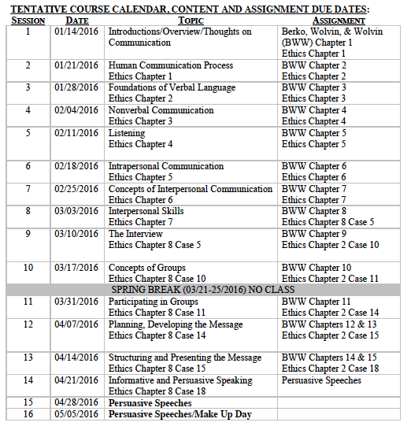
Tentative Course

Slide 4
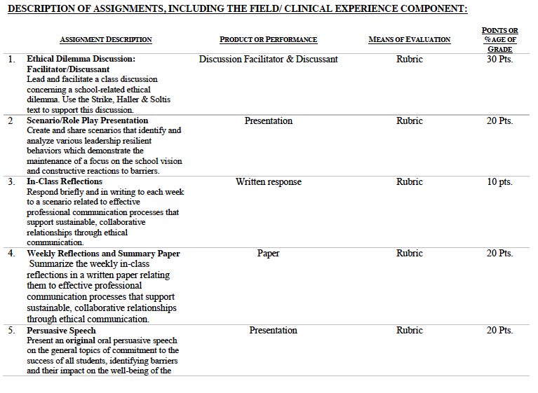

Slide 5
Consider the ethical implications
Palm Beach County principal arrested on theft charges
January 4, 2011
Principal Priscilla Maloney
http://articles.sun-sentinel.com/2011-01-04/news/fl-priscilla-maloney-principal-arrest20110104_1_theft-charges-plumosa-school-maloney-case

Slide 6
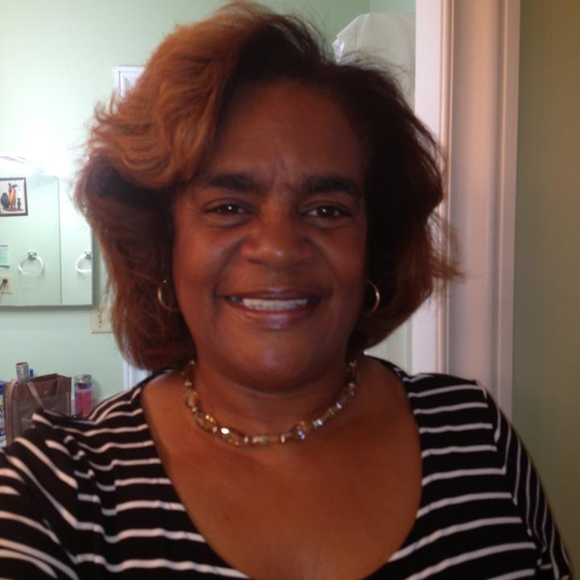
Consider the ethical implications
Delores Brown arrested, charged with stealing $25,000 of elementary school furniture for her funeral home
January 26, 2012
Area Director Delores Brown
http://www.browardpalmbeach.com/news/delores-brown-arrested-charged-with-stealing-25-000-of-elementary-school-furniture-for-her-funeral-home-6453384

Slide 7

Unpacking the Florida Principal Leadership Standards
The State of FL Principal Leadership Standards addressed:
  Domain 1: Student Achievement
            Standard 1: Student Learning Results
            Effective school leaders achieve results on the school’s
            student learning goals.
  Domain 4: Professional and Ethical Behaviors
            Standard 10: Professional and Ethical Behaviors
            Effective school leaders demonstrate personal and
            professional behaviors consistent with quality practices in
            education and as a community leader.

Slide 8
Leadership Clock Buddies
Purpose:
To support collaborative educational leadership researcher pairs for effective leadership communication.
Instructions:
Book an appointment with 12 different educational leadership researchers (one for each hour of the leadership clock).
Ensure that you both record the appointment on the leadership clocks.
Book the appointment if there is a vacant slot at the hour for both of your leadership clocks.
Josh
Tamar
Terrence’s Leadership Clock EDU 615

Slide 9
Chapter 5: The self and perception
Define and explain the concept of intrapersonal communication.
State and discuss the theory of basic drive forces as they affect inner communication.
Explain self-concept and its role as a guiding factor in a person’s actions.
Define self-talk and explain its relation to our communication accomplishments.
List some options and sources for improving self-perception, self-confidence and self-esteem (all of them).

Slide 10
Chapter 5: The self and perception
  6. Define and explain the causes, results, effects, and aids
    for communication apprehension.
  7. Evaluate how culture has an effect on self-
    communication and the development of
    self-perception.
  8. Explain the role of perception on communication.

Slide 11
Chapter 5:
Educational evaluation
Turn and Talk
Does it seem like the Principle of Benefit Maximization presuppose the Principle of Equal Respect?
Has Kaufmann behaved unethically?
Consider the discipline, individual differences and lesson objectives standards involved in this case. Do these meet the clarity standard required for due process? Why or why not?
What purpose do grades serve? How might different answers to this question affect your view of fair procedures for assigning grades?

Slide 12
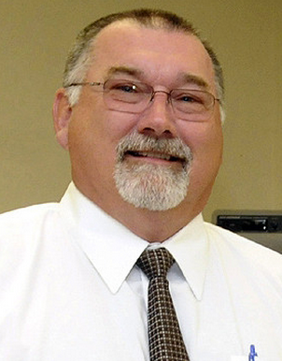
Consider the ethical implications
West Boca principal keeps money, loses school in plagiarism case
July 22, 2015
Principal Mark Stenner
http://www.sun-sentinel.com/local/palm-beach/fl-principal-plagiarism-follow-20150722-story.html

Slide 13

In-Class Reflection (ongoing)
    Respond briefly and in writing each week to a scenario related to effective professional communication processes that support sustainable, collaborative relationships through ethical communication.
    You may use the scenario in the assigned textbook chapter or one that was discussed in class.
    The length should be at least one full page, typed, double spaced, Times New Roman font size 12.
    Must have a cover page and reference page(s).
    Use APA format (refer to the APA manual and page 9 of the syllabus).
    Refer to the Written In-Class Assignment Rubric in page 19 of the syllabus.
    Bring a copy to class for discussion.

Slide 14
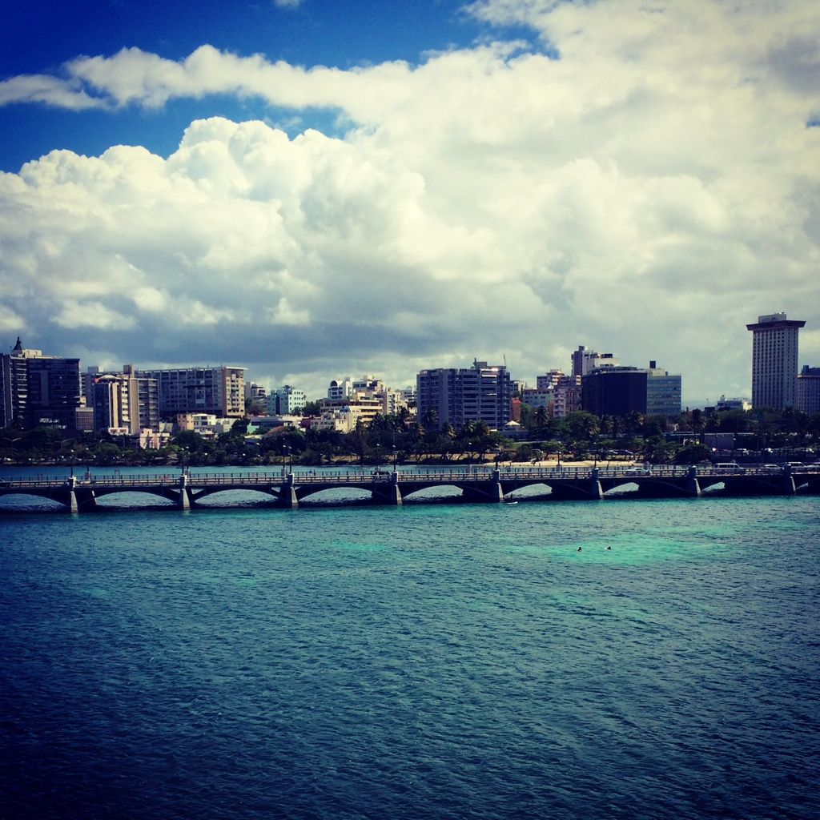
Weekly Reflections and Summary Paper (ongoing)
    Summarize the weekly in-class reflections in a written paper relating them to effective professional communication processes that support sustainable, collaborative relationships through ethical communication.
    Double spaced, Times New Roman, font size 12.
    Must have a cover page and reference page(s).
    Use APA format (refer the APA manual and page 9 of the syllabus).
    Bring a copy to class for discussion.

Slide 15
Scenario/Role Play Presentation
    Create and share scenarios that identify and analyze various leadership resilient behaviors which demonstrate the maintenance of a focus on the school vision and constructive reactions to barriers.
Relevant Scenario
Assign Roles
Develop Storyboard
Act Your Role
Debrief
Identify the Problem Find a Solution

Slide 16
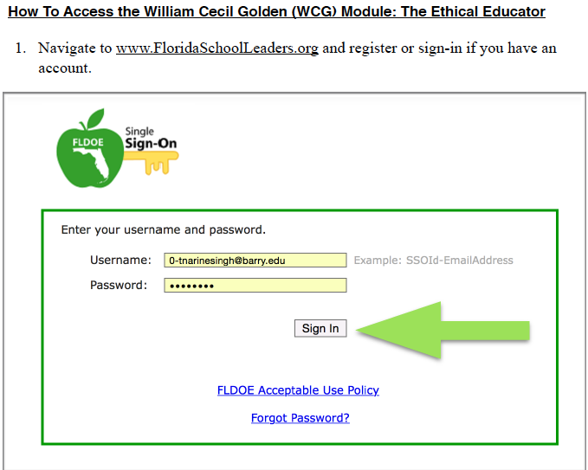

Slide 17
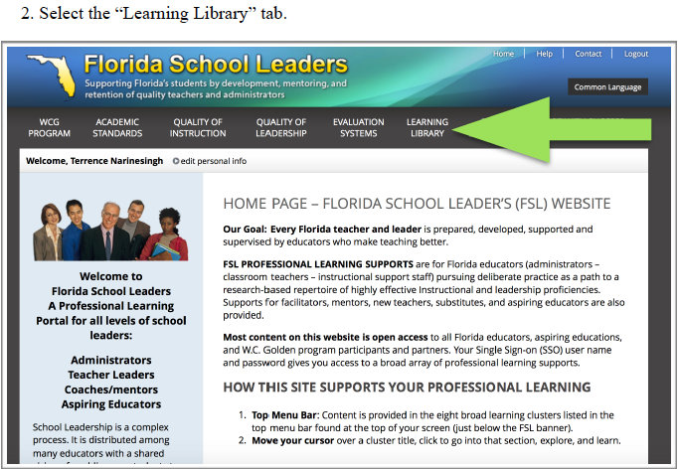

Slide 18
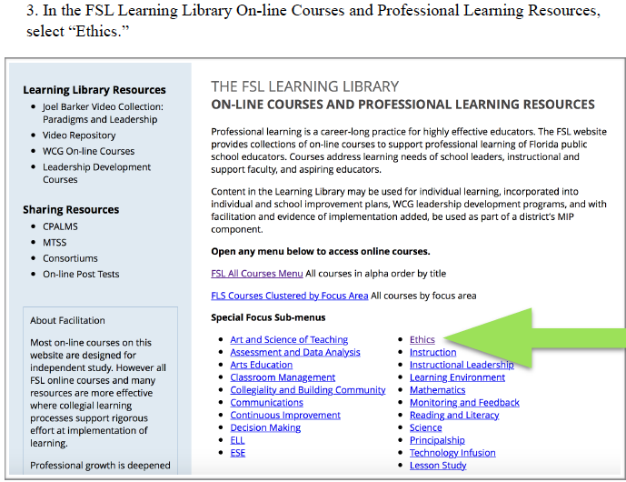

Slide 19
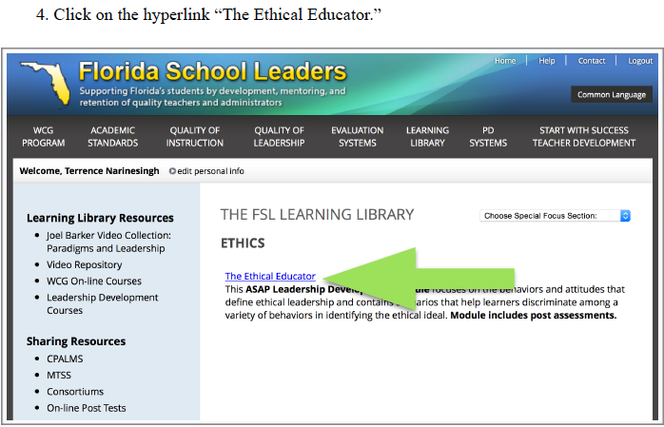

Slide 20
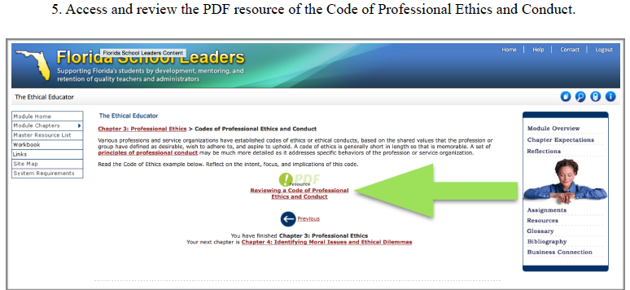

Slide 21
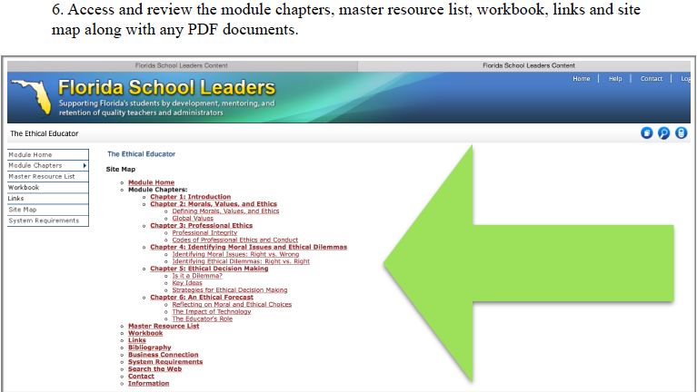

Slide 22
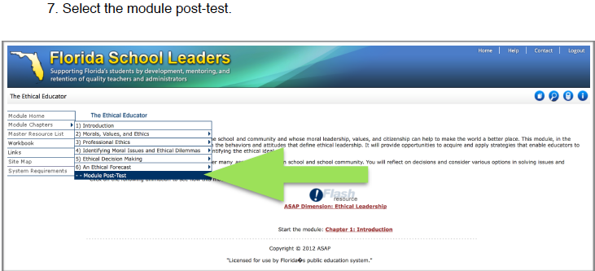

Slide 23
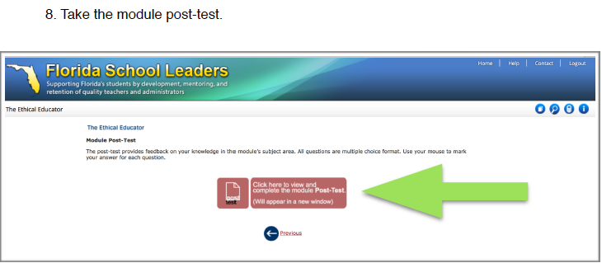

Slide 24
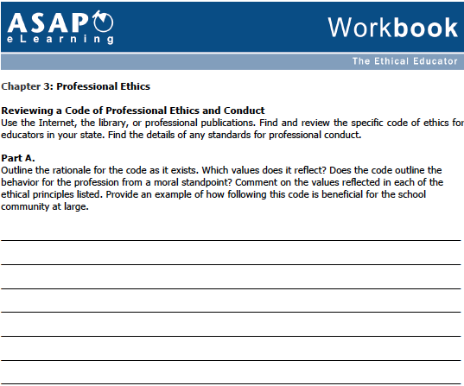

Slide 25
In-Basket Activity
If you have a GREEN folder with your course syllabus, your role in the activity is an elementary School Principal. You can select ONE Assistant Principal with a RED or ORANGE folder.
If you have a BLUE folder, you are a middle or high School Principal. You can select up to 3 Assistant Principals with a RED or ORANGE folder.
ELEMENTARY PRINCIPAL
MIDDLE/HIGH PRINCIPAL

Slide 26
In-Basket Activity
Using the Code of Ethics of the Education Profession in Florida and the Florida Principal Leadership Standards, examine the assigned scenario.
1. What possible issues/concerns might this scenario raise?
2. How could this situation become a violation of the law, the “Code” or other school/district policies?
3. In this situation, what are some potential negative consequences for the teacher/administrator, for the students and the school community?
4. What responses/actions will result in a more positive outcome and/or what proactive measures might be considered?
Principals, be ready to share out in 10 minutes!

Slide 27
Wrap Up
Review
Next week Assignments:
      In-Class Reflection
      Weekly Reflections and Summary Paper
      Readings - BWW Chapter 6, Ethics Chapter 6
      Preparation for Scenario/Role Play Presentation (refer to the Communication rubric on the EDU 615 syllabus)

Slide 28
References
Abdill, R. (2012, January). Delores Brown arrested, charged with stealing $25,000 of elementary school furniture for her funeral
    home. Broward Palm Beach New Times. Retrieved from palm-beach/fl-principal-plagiarism-follow-20150722-story.html
APA (2010). Publication manual of the American Psychological Association (6th ed.). Washington, DC: American Psychological Association.
Berko, R., Wolvin, A., & Wolvin, D. & Aitken, J. (2012). The self and perception. In K. Bowers & M. Mashburn (Eds.),
    Communicating: A social, cultural and career focus (12th ed.) (pp. 106-129). Boston, MA: Pearson.
Florida School Leaders. (2016, January). The William Cecil Golden school leadership development program. Retrieved from the Florida Department of
    Education website http://www.floridaschoolleaders.org
Freeman, M. (2011, January). Palm Beach county principal arrested on theft charges. Sun Sentinel. Retrieved from 2011-01-04/news/fl-priscilla-
    maloney-principal-arrest20110104_1_theft-charges-plumosa-school-maloney-case
Scott, T. (2015, July). West Boca principal keeps money, loses school in plagiarism case. Sun Sentinel. Retrieved from palm-beach/fl-principal-plagiarism-
    follow-20150722-story.html
Strike, K.A., Haller, E.J. & Soltis, J.E. (2005). Educational evaluation. In K.A. Strike (Ed.), The ethics of school administration (3rd
    ed.) (pp. 75-92). New York, NY: Teachers College.

