Slide 1


EDU 615
Ethics and Communication for Leaders
Week #8: Thursday, March 3, 2016
Terrence narinesingh, ed.s.
adjunct professor
Adrian Dominican school of education
educational leadership

Slide 2

Agenda
Welcome
Tentative Course Calendar and Assignment
Ethical Implications Discussion
Unpacking the Florida Principal Leadership Standards
Leadership Clock Buddies Activity
Berko, R., Wolvin, A., & Wolvin, D. & Aitken, J. (2012). Interpersonal skills and conflict management.
In K. Bowers & M. Mashburn (Eds.), Communicating: A social, cultural and career focus (12th ed.) (pp. 173-209).
Boston, MA: Pearson.
Strike, K.A., Haller, E.J. & Soltis, J.E. (2005). Diversity: Multiculturalism and religion. In K.A. Strike (Ed.), The ethics of school
administration (3rd ed.) (pp. 127-158). New York, NY: Teachers College.
In-Class Reflection and Weekly Reflections and Summary Paper Feedback
Embedded scenario/role play collaboration
Problem-based Learning using the Florida Principal Leadership Standards
Next Week: Ongoing readings, scenario/role play presentation, and ethical dilemma discussion

Slide 3
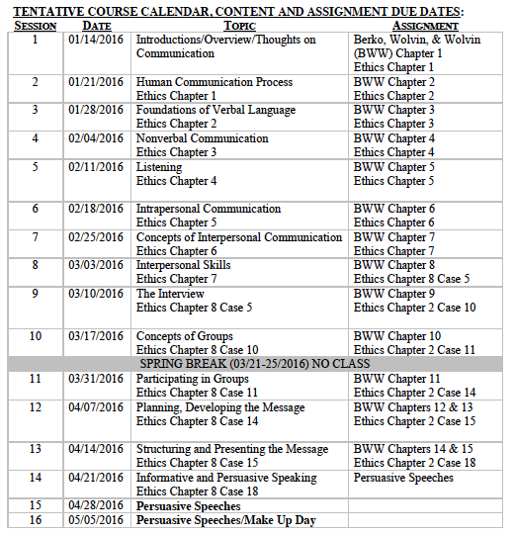
Tentative Course

Slide 4
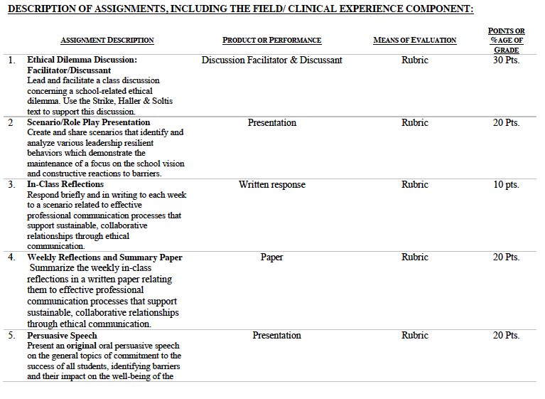

Slide 5
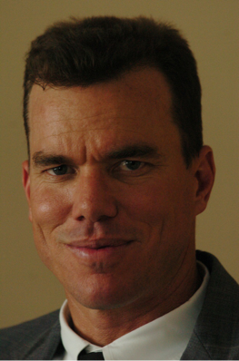
Consider the ethical implications
Accusing ex of hacking his email, Boca High principal sues district
June 5, 2015
Geoff McKee
http://extracredit.blog.palmbeachpost.com/2015/06/05/accusing-ex-of-hacking-his-email-boca-high-principal-sues-school-district/

Slide 6

Unpacking the Florida Principal Leadership Standards
The State of FL Principal Leadership Standards addressed:
Domain 1: Student Achievement
Standard 1: Student Learning Results
Effective school leaders achieve results on the school’s
student learning goals.
Domain 4: Professional and Ethical Behaviors
Standard 10: Professional and Ethical Behaviors
Effective school leaders demonstrate personal and
professional behaviors consistent with quality practices in
education and as a community leader.

Slide 7
Leadership Clock Buddies
Purpose:
To support collaborative educational leadership researcher pairs for effective leadership communication.
Instructions:
Book an appointment with 12 different educational leadership researchers (one for each hour of the leadership clock).
Ensure that you both record the appointment on the leadership clocks.
Book the appointment if there is a vacant slot at the hour for both of your leadership clocks.
Terrence’s Leadership Clock EDU 615
Karen
Francesca

Slide 8
Chapter 7: Interpersonal skills and conflict management
Explain the presentational, listening, and nonverbal concepts of communication.
State the rules for giving details, organizing ideas, and using appropriate terms in giving directions.
Define empathy and explain how to communicate empathically.
Discuss the process of ascertaining information, asking for change, and questioning.
Apply the process of apologizing.

Slide 9
Chapter 7: Interpersonal skills and conflict management
6. Define interpersonal conflict.
7. Evaluate anger and explain it as a negative and positive
emotion.
8. Explain negotiation, avoidance, accommodation/
smoothing over, compromise, competition, integration,
and fighting fair as they relate to conflict.
9. Differentiate the win-lose, lose-lose, and win-win styles of
negotiation.
10. Apply the role of culture as it relates to conflict resolution,
apologizing and criticism.

Slide 10
Chapter 7:
Diversity, multiculturalism and religion
Turn and Talk
Do schools have a right to affirm some people’s knowledge and marginalize that of others? Who gets to decide what schools will view as the truth or what questions are open to debate?
Should the school work to create a shared American culture? Or should it try to respect each culture equally?
There are multicultural as well as multireligious differences in the school population at Tenderville. Should different cultures also be addressed in school policy and the school’s curriculum? How?

Slide 11
Ethical Dilemma Discussion
Facilitator/Discussant (30 points)
Lead and facilitate a class discussion concerning a school-related ethical dilemma using supporting details from the text.
Admin Team 1
Mercie
Roseline
Tamar
Karen
Francesca
Admin Team 2
Patience
Jeralene
Rebecca
Jennifer
Cindy
Admin Team 3
Monica
Joshua
Martha
Barbara
Justinvil

Slide 12

In-Class Reflection (best sample)
Respond briefly and in writing each week to a scenario related to effective professional communication processes that support sustainable, collaborative relationships through ethical communication.
You may use the scenario in the assigned textbook chapter or one that was discussed in class.
The length should be at least one full page, typed, double spaced, Times New Roman font size 12.
Must have a cover page and reference page(s).
Use APA format (refer to the APA manual and page 9 of the syllabus).
Refer to the Written In-Class Assignment Rubric in page 19 of the syllabus.
Bring a copy to class for discussion.

Slide 13
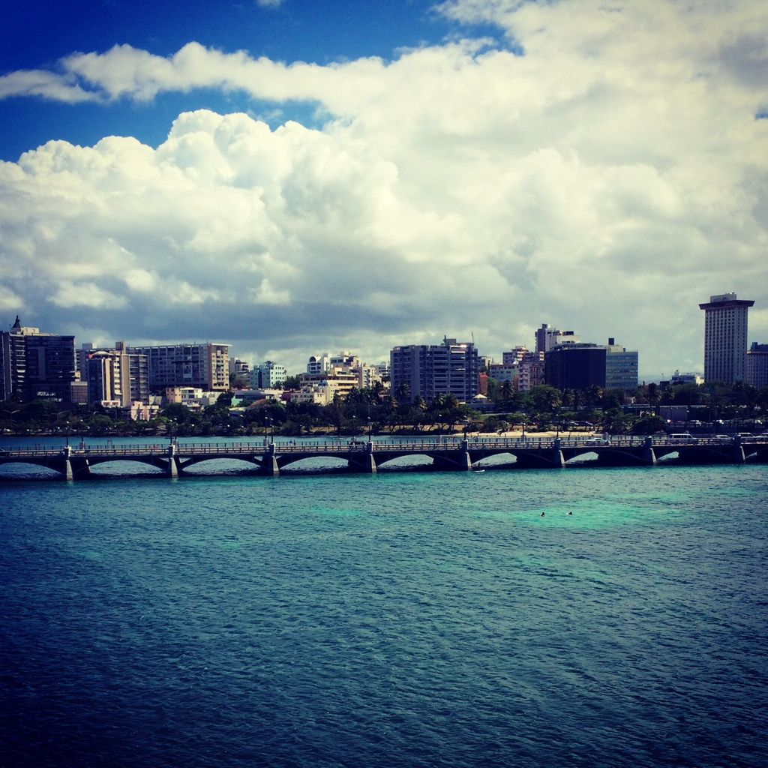
Weekly Reflections and Summary Paper (ongoing)
Summarize the weekly in-class reflections in a written paper relating them to effective professional communication processes that support sustainable, collaborative relationships through ethical communication.
Double spaced, Times New Roman, font size 12.
Must have a cover page and reference page(s).
Use APA format (refer the APA manual and page 9 of the syllabus).
Bring a copy to class for discussion.

Slide 14
Embedded Scenario/Role Play Presentation Collaboration
Create and share scenarios that identify and analyze various leadership resilient behaviors which demonstrate the maintenance of a focus on the school vision and constructive reactions to barriers.
Relevant Scenario
Develop Storyboard
Assign Roles
Act Your Role
Debrief
Identify the Problem Find a Solution

Slide 15
In-Basket Activity
If you have a GREEN folder with your course syllabus, your role in the activity is an elementary School Principal. You can select ONE Assistant Principal with a RED or ORANGE folder.
If you have a BLUE folder, you are a middle or high School Principal. You can select up to 3 Assistant Principals with a RED or ORANGE folder.
ELEMENTARY PRINCIPAL
MIDDLE/HIGH PRINCIPAL

Slide 16
In-Basket Activity
Using the Code of Ethics of the Education Profession in Florida and the Florida Principal Leadership Standards, examine the assigned scenario.
1. What possible issues/concerns might this scenario raise?
2. How could this situation become a violation of the law, the “Code” or other school/district policies?
3. In this situation, what are some potential negative consequences for the teacher/administrator, for the students and the school community?
4. What responses/actions will result in a more positive outcome and/or what proactive measures might be considered?
Principals, be ready to share out in 10 minutes!

Slide 17
Wrap Up
Review
Next week Assignments:
Readings - BWW Chapter 8, Ethics Chapter 8
Preparation for Scenario/Role Play Presentation (refer to the Communication rubric on the EDU 615 syllabus)
Preparation for the Ethical Dilemma

Slide 18
References
APA (2010). Publication manual of the American Psychological Association (6th ed.). Washington, DC: American Psychological Association.
Berko, R., Wolvin, A., & Wolvin, D. & Aitken, J. (2012). Interpersonal skills and conflict management. In K. Bowers & M. Mashburn (Eds.),
Communicating: A social, cultural and career focus (12th ed.) (pp. 173-209). Boston, MA: Pearson.
Florida School Leaders. (2016, January). The William Cecil Golden school leadership development program. Retrieved from the Florida Department of
Education website http://www.floridaschoolleaders.org
Marra, A. (2015, June). Accusing ex of hacking his e-mail, Boca High principal sues district. Palm Beach Post. Retrieved from http://
extracredit.blog.palmbeachpost.com/2015/06/05/accusing-ex-of-hacking-his-email-boca-high-principal-sues-school-district/
Strike, K.A., Haller, E.J. & Soltis, J.E. (2005). Diversity: multiculturalism and religion . In K.A. Strike (Ed.), The ethics of school administration (3rd ed.)
(pp. 127-158). New York, NY: Teachers College.

