Slide 1


EDU 615
Ethics and Communication for Leaders
Week #9: Thursday, March 10, 2016
Terrence narinesingh, ed.s.
adjunct professor
Adrian Dominican school of education
educational leadership

Slide 2

Agenda
Welcome
Tentative Course Calendar and Assignment
Ethical Implications Discussion
Unpacking the Florida Principal Leadership Standards
Leadership Clock Buddies Activity
Berko, R., Wolvin, A., & Wolvin, D. & Aitken, J. (2012). The interview. In K. Bowers & M. Mashburn (Eds.), Communicating:
    A social, cultural and career focus (12th ed.) (pp. 211-242). Boston, MA: Pearson.
STAR Format of Interviewing
Strike, K.A., Haller, E.J. & Soltis, J.F. (2005). Supplemental cases. In K.A. Strike (Ed.), The ethics of school
    administration (3rd ed.) (pp. 159-170). New York, NY: Teachers College.
In-Class Reflection and Weekly Reflections and Summary Paper Feedback
Embedded scenario/role play collaboration
Problem-based Learning using the Florida Principal Leadership Standards
Next Week: Ongoing readings, scenario/role play presentation, and ethical dilemma discussion

Slide 3
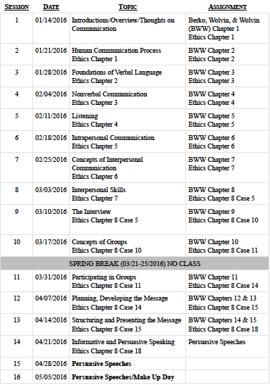
Tentative Course

Slide 4
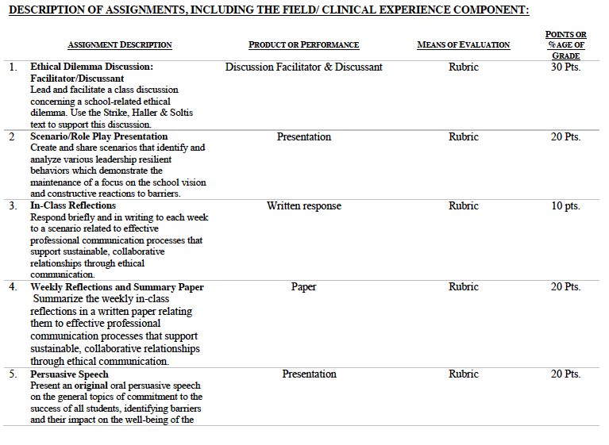

Slide 5
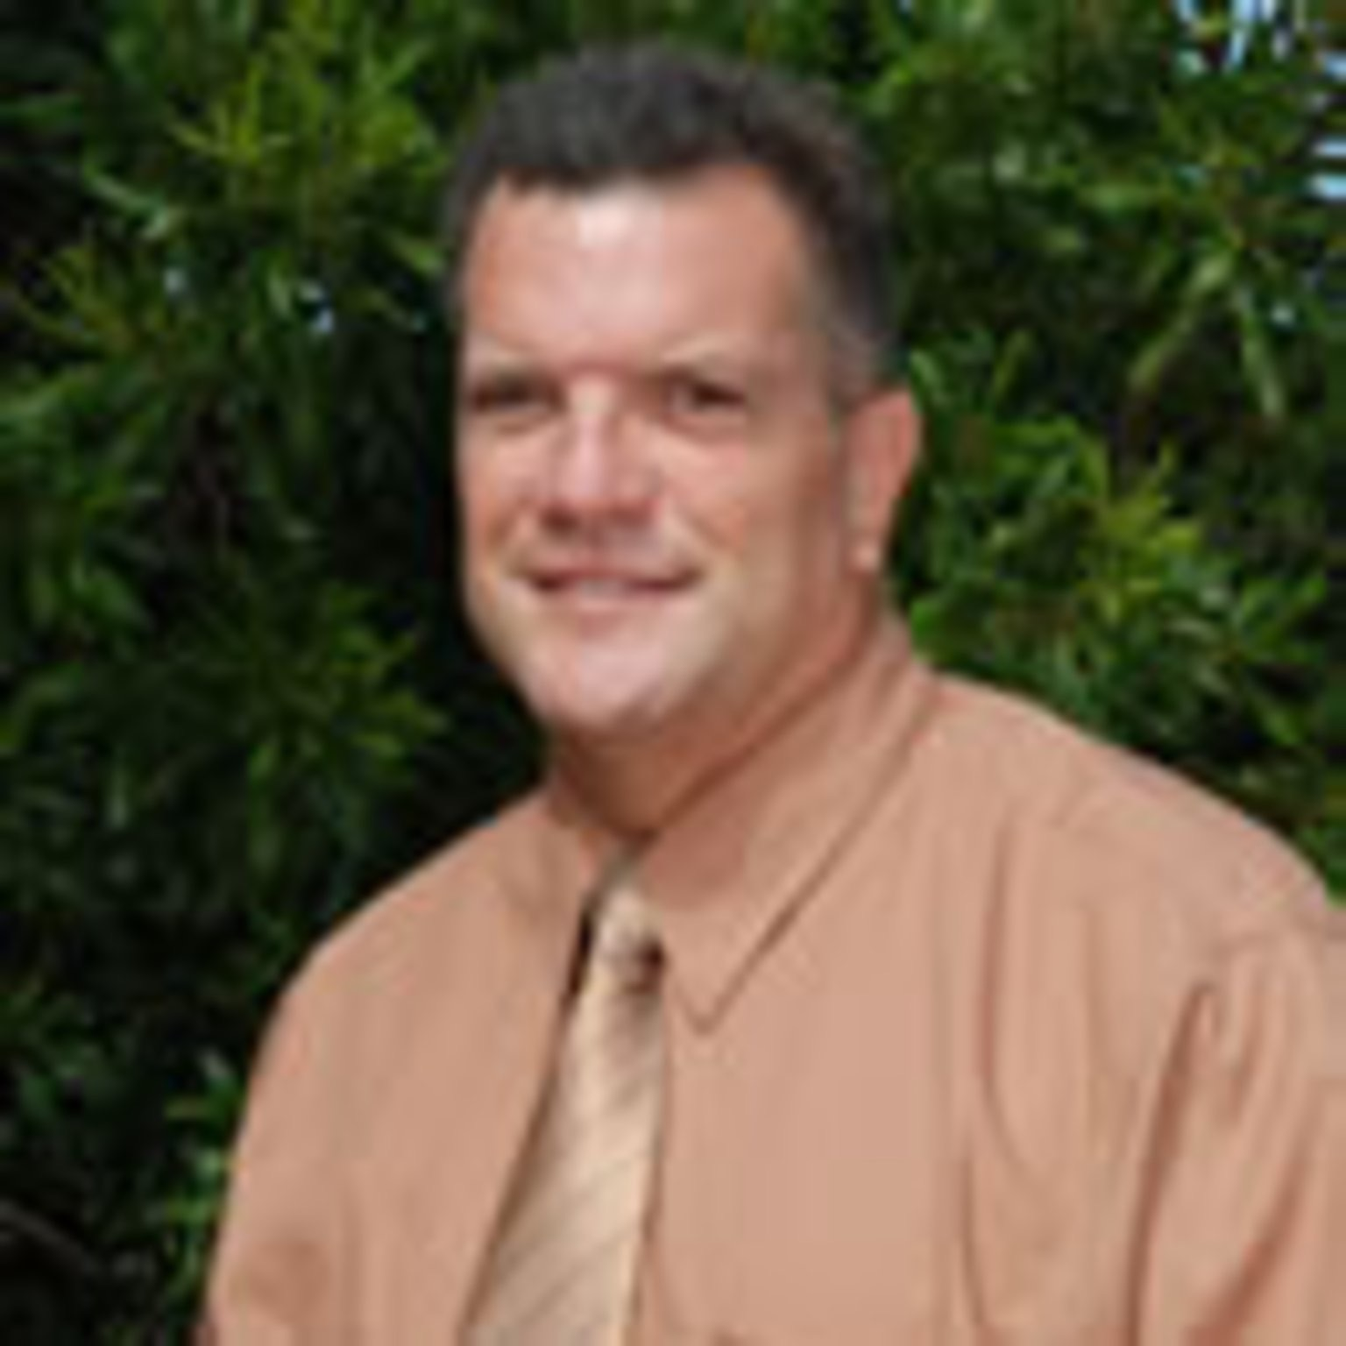
Consider the ethical implications
Don Estridge High Tech Middle principal Dave Benson reassigned
June 6, 2013
Dave Benson, Principal
http://extracredit.blog.palmbeachpost.com/2013/05/06/don-estridge-high-tech-middle-principal-dave-benson-reassigned/

Slide 6

Unpacking the Florida Principal Leadership Standards
The State of FL Principal Leadership Standards addressed:
  Domain 1: Student Achievement
            Standard 1: Student Learning Results
            Effective school leaders achieve results on the school’s
            student learning goals.
  Domain 4: Professional and Ethical Behaviors
            Standard 10: Professional and Ethical Behaviors
            Effective school leaders demonstrate personal and
            professional behaviors consistent with quality practices in
            education and as a community leader.

Slide 7
Leadership Clock Buddies
Purpose:
To support collaborative educational leadership researcher pairs for effective leadership communication.
Instructions:
Book an appointment with 12 different educational leadership researchers (one for each hour of the leadership clock).
Ensure that you both record the appointment on the leadership clocks.
Book the appointment if there is a vacant slot at the hour for both of your leadership clocks.
Terrence’s Leadership Clock EDU 615
Litzrudy

Slide 8
Chapter 8: The Interview
Define what an interview is and identify the types of interviews.
List and explain the different purposes for interviews and how those purposes affect what happens in the interview.
Demonstrate the organizational structure of an interview.
State the principles of preparing for and functioning as an interviewee and an interviewer.
Identify and illustrate the types of questions used in an interview.

Slide 9

STAR Targeted Selection Interviewing
Elements of the STAR:
S/T - Situation/Task That You Faced
        Example: Describe a situation…
A - Actions That You Took
        Example: What steps did you do in the situation?
R - Results or changes caused by these actions
        Example: What were the results?

Slide 10
STAR Targeted Selection Interviewing
RATING SCALE
1 | Much less than acceptable
2 | Less than acceptable
3 | Acceptable
4 | More than acceptable
5 | Much more than acceptable

Slide 11
Chapter 8: Supplemental Cases
Case 5
Turn and Talk
Do you believe that Mr. Blain is acting dishonestly or unethically? Why or why not?
Does the fact that the board of education has tacitly accepted his midwinter vacation justify it? If they simply granted him a paid midwinter vacation as a fringe benefit would that justify it?
Suppose it really is true that Mr. Blain is a more effective superintendent because of his midwinter vacation. Does that justify it?

Slide 12
Scenario/Role Play (20 points)
Create and share scenarios that identify and analyze various leadership resilient behaviors which demonstrate the maintenance of a focus on the school vision and constructive reactions to barriers.
Ethical Dilemma Discussion Facilitator/Discussant (30 points)
Lead and facilitate a class discussion concerning a school-related ethical dilemma using supporting details from the text.
Admin Team 1
Mercie
Roseline
Tamar
Karen
Francesca
Admin Team 2
Patience
Jeralene
Rebecca
Jennifer
Cindy
Admin Team 3
Monica
Joshua
Martha
Barbara
Litzrudy

Slide 13

In-Class Reflection (best sample)
    Respond briefly and in writing each week to a scenario related to effective professional communication processes that support sustainable, collaborative relationships through ethical communication.
    You may use the scenario in the assigned textbook chapter or one that was discussed in class.
    The length should be at least one full page, typed, double spaced, Times New Roman font size 12.
    Must have a cover page and reference page(s).
    Use APA format (refer to the APA manual and page 9 of the syllabus).
    Refer to the Written In-Class Assignment Rubric in page 19 of the syllabus.
    Bring a copy to class for discussion.

Slide 14
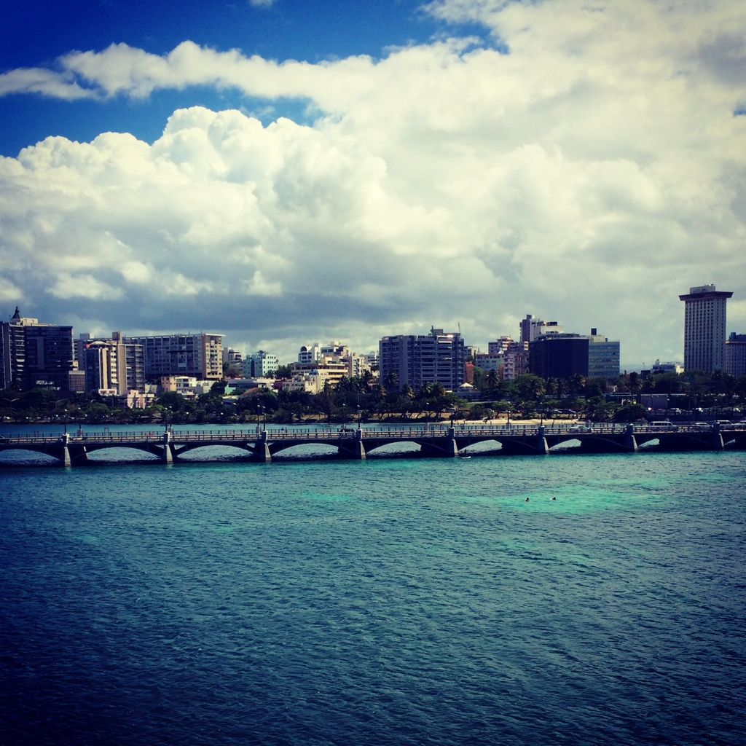
Weekly Reflections and Summary Paper (ongoing)
    Summarize the weekly in-class reflections in a written paper relating them to effective professional communication processes that support sustainable, collaborative relationships through ethical communication.
    Double spaced, Times New Roman, font size 12.
    Must have a cover page and reference page(s).
    Use APA format (refer the APA manual and page 9 of the syllabus).
    Bring a copy to class for discussion.

Slide 15
Embedded Scenario/Role Play Presentation Collaboration
    Create and share scenarios that identify and analyze various leadership resilient behaviors which demonstrate the maintenance of a focus on the school vision and constructive reactions to barriers.
Relevant Scenario
Develop Storyboard
Assign Roles
Act Your Role
Debrief
Identify the Problem Find a Solution

Slide 16
In-Basket Activity
If you have a GREEN folder with your course syllabus, your role in the activity is an elementary School Principal. You can select ONE Assistant Principal with a RED or ORANGE folder.
If you have a BLUE folder, you are a middle or high School Principal. You can select up to 3 Assistant Principals with a RED or ORANGE folder.
ELEMENTARY PRINCIPAL
MIDDLE/HIGH PRINCIPAL

Slide 17
In-Basket Activity
Using the Code of Ethics of the Education Profession in Florida and the Florida Principal Leadership Standards, examine the assigned scenario.
1. What possible issues/concerns might this scenario raise?
2. How could this situation become a violation of the law, the “Code” or other school/district policies?
3. In this situation, what are some potential negative consequences for the teacher/administrator, for the students and the school community?
4. What responses/actions will result in a more positive outcome and/or what proactive measures might be considered?
Principals, be ready to share out in 10 minutes!

Slide 18
Wrap Up
Review
Next week Assignments:
      Readings - BWW Chapter 9, Ethics Chapter 8 (Case 10)
      Preparation for Scenario/Role Play Presentation (refer to the Communication rubric on the EDU 615 syllabus)
      Preparation for the Ethical Dilemma

Slide 19
References
APA (2010). Publication manual of the American Psychological Association (6th ed.). Washington, DC: American Psychological Association.
Berko, R., Wolvin, A., & Wolvin, D. & Aitken, J. (2012). The interview. In K. Bowers & M. Mashburn (Eds.), Communicating: A social, cultural and career
focus (12th ed.) (pp. 211-242). Boston, MA: Pearson.
Florida School Leaders. (2016, January). The William Cecil Golden school leadership development program. Retrieved from the Florida Department of
      Education website http://www.floridaschoolleaders.org
Ross, A. (2013, May). Don Estridge High Tech Middle principal Dave Benson reassigned. Palm Beach Post. Retrieved from http://
extracredit.blog.palmbeachpost.com/2013/05/06/don-estridge-high-tech-principal-dave-benson-reassigned/
Strike, K.A., Haller, E.J. & Soltis, J.F. (2005). Supplemental cases. In K.A. Strike (Ed.), The ethics of school administration (3rd ed.)
(pp. 159-170). New York, NY: Teachers College.

