Slide 1


EDU 687
Emerging Technologies and Educational Leadership
Week #6: Tuesday, June 21, 2016
Terrence narinesingh, ed.s.
adjunct professor
Adrian Dominican school of education
educational leadership

Slide 2

Agenda
Objectives
The Florida Principal Leadership Standards
Assigned Readings: Chapters 7 Key Concepts, Questions and Activities
William Cecil Golden (WCG) School Leadership Development Program, 5A & 8A - Due June 21, 2016
Technology Rotation Plan - Due June 28, 2016
References

Slide 3
Objectives of this session
The educational leadership researcher will be able to:
engage reluctant learners through technology.
administrative decision making and technology.
address equity issues.
discuss the uses of social media for administrative communication.

Slide 4
Remind
App
People text your class code to this number to join EDU 687. Your personal phone number is never shared.
Enter this number
81010
Text this message
@edu68
People use this unique code to this number to join and receive messages from EDU 687.

Slide 5
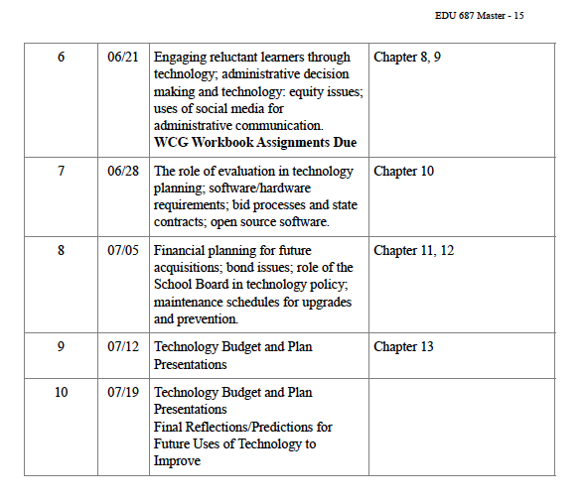
EDU 687 Tentative
Course Calendar
Online class 06/21

Slide 6

The Florida Principal
Leadership Standards
The State of FL Principal Leadership Standards addressed:
Standard 8: School Management
Effective school leaders manage the organization, operations, and facilities in
ways that maximize the use of resources to promote a safe, efficient, legal, and
effective learning environment.
Standard 9: Communication
Effective school leaders practice two-way communications and use appropriate
oral, written, and electronic communication and collaboration skills to
accomplish school and system goals by building and maintaining relationships
with students, faculty, parents, and community.

Slide 7

Complete the online notebook using the textbook and presentation.

Slide 8
Chapter 7:
Multimedia in education: key points
Read Chapter 7: Multimedia in education (p. 115-132).
Key points to consider:
Reviews the development and use of multimedia technologies in education.
Focus is on instruction. Interest and investment increases and appeals to teachers/students.
Definition of multimedia as it pertains to educational technology.

Slide 9
Chapter 7:
Multimedia in education: key points
Challenge of educating students to thrive in a multimedia-dependent society
Multimedia includes both hardware and software components.
Multimedia can be used to enhance instruction by teacher presentations, student projects and discovery learning.
Educators need to be cognizant of copyright infringement in utilizing copyright material (video, images and sound).

Slide 10
Chapter 7:
Multimedia in education
Key concepts and questions
Multimedia technology has been evolving slowly but steadily during the past decade. How has this technology affected your daily activities? How do you see multimedia developing in the 21st century?
Multimedia means different things to different people. How do you define multimedia?
Multimedia is frequently used in conjunction with the application of technology for a variety of applications. Is multimedia strictly a technological phenomenon? Or does it have some theoretical basis for teaching and learning? Explain.
Literacy is a frequently used term in education and generally refers to language (reading and writing). Explain literacy in conjunction with multimedia. Does a need exist for developing multimedia literacy? Explain.

Slide 11
Chapter 7:
Multimedia in education
Key concepts and questions
5. Multimedia can include a variety of hardware components. How are multimedia hardware components changing? Which do you consider the most beneficial for education? Why?
6. Multimedia can be used in a variety of applications. How would you differentiate multimedia applications as used by teachers for presenting lessons as opposed to use by students in learning?
7. Locating multimedia resources such as video, images, and sounds can be a time-consuming activity. If you were to design a multimedia project, how would you locate appropriate material? Do you need to be concerned about copyright in using this material? Explain.

Slide 12
Creating critical thinkers through media literacy: Andrea Quijada at TEDxABQED
https://www.youtube.com/watch?v=aHAApvHZ6XE
Explain how the media can be a tool for self-determination and movement building.

Slide 13
Signing into Single Sign On (SSO)
For Educators and Guest Access
Updated: 3/10/15

Slide 14
Signing into SSO
Your path to logging into SSO depends on the authentication method selected by your school district/organization.
Federated
Hosted
Your login credentials are the same as your local network logon.
Your login credentials are provided by FDOE via email.
Notes:
Present Slide.

Slide 15
Federated Districts (48)
Hosted Districts (25)
ALACHUA
BAKER
BRADFORD
BREVARD
BROWARD
CHARLOTTE
CLAY
COLLIER
DADE
DESOTO
DUVAL
ESCAMBIA
FL DEAF/BLIND
FL VS FULL TIME
GADSDEN
GILCHRIST
GLADES
HAMILTON
HARDEE
HIGHLANDS
HILLSBOROUGH
INDIAN RIVER
JACKSON
LAKE
LEE
LEON
LEVY
MANATEE
MARION
OKALOOSA
OKEECHOBEE
ORANGE
OSCEOLA
P.K. YONGE
PALM BEACH
PINELLAS
POLK
PUTNAM
SANTA ROSA
SARASOTA
SEMINOLE
ST. JOHNS
ST. LUCIE
SUWANNEE
UNION
VOLUSIA
WAKULLA
WALTON
BAY
CALHOUN
CITRUS
COLUMBIA
DIXIE
FAMU LAB SCH
FAU LAB SCH
FLAGLER
FRANKLIN
FSU LAB SCH
GULF
HENDRY
HERNANDO
HOLMES
JEFFERSON
LAFAYETTE
LIBERTY
MADISON
MARTIN
MONROE
NASSAU
PASCO
SUMTER
TAYLOR
WASHINGTON
GLADESHIGHLANDS
GADSDEN
Current as of 3/10/15.
Notes:
Present Slide.
Additional Information:
Hosted
33 Districts
29,849 Users (9%)
Federated
40 Districts
294,952 Users (91%)

Slide 16

Step One
Open an internet web browser

Slide 17
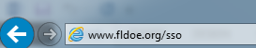
Step Two
Go to www.fldoe.org/sso

Slide 18
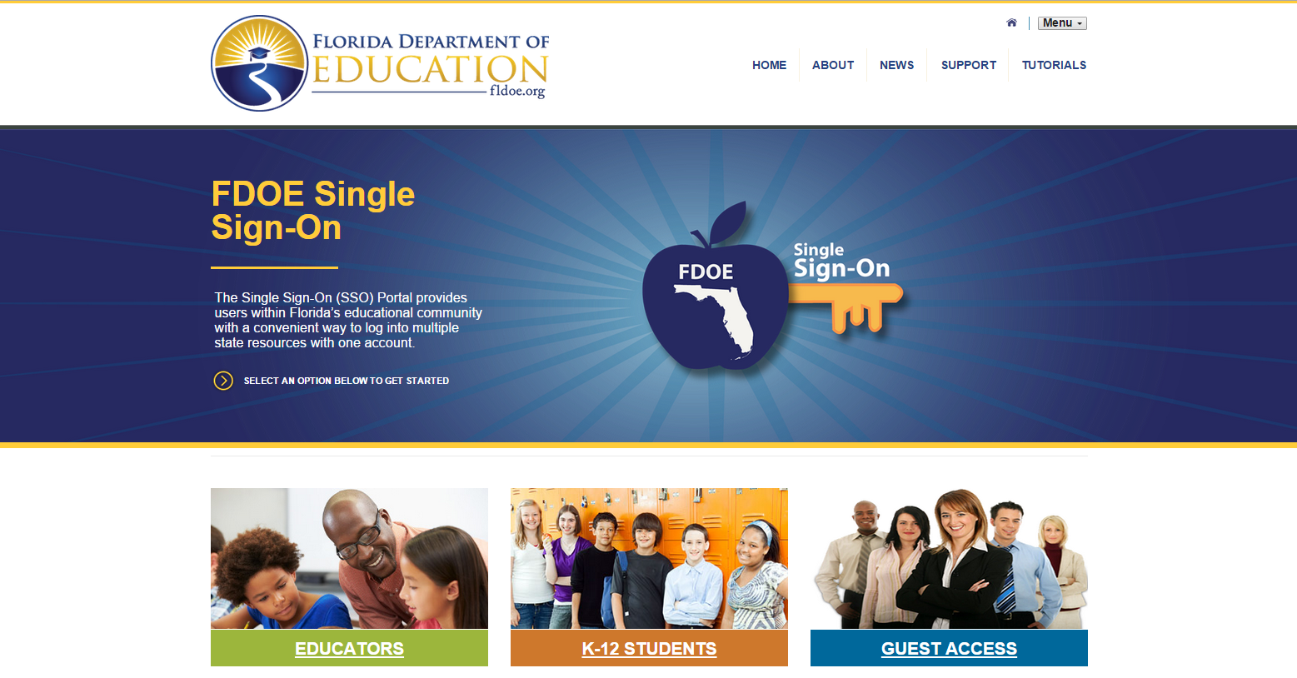
Step Three
Choose the appropriate option for login.
Note – Individuals employed by an educational organization, whether they teach or not, should choose Educators.

Slide 19
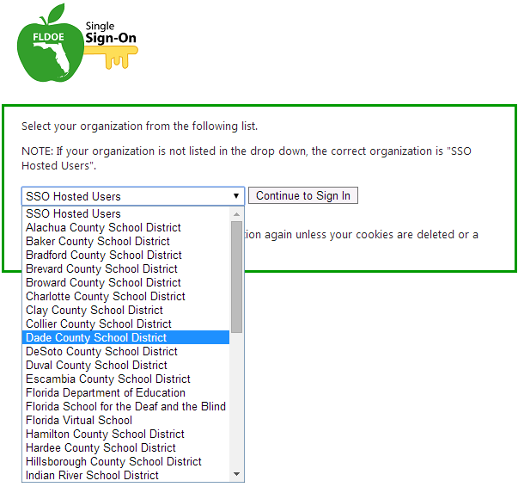
Step Four
When prompted to select an organization, use the drop down list to locate the public school district or organization to which you are a member.

Slide 20
I see my school district.
I don’t see my school district.
School districts specifically listed in the drop down indicates the organization is federated.
Select your school district, and then click Continue to Sign In
Your login credentials are the same as your local network logon.
School districts NOT listed in the drop down indicates the organization is hosted.
Select SSO Hosted Users, and then click Continue to Sign In.
Your login credentials are provided by FDOE via email.

Slide 21
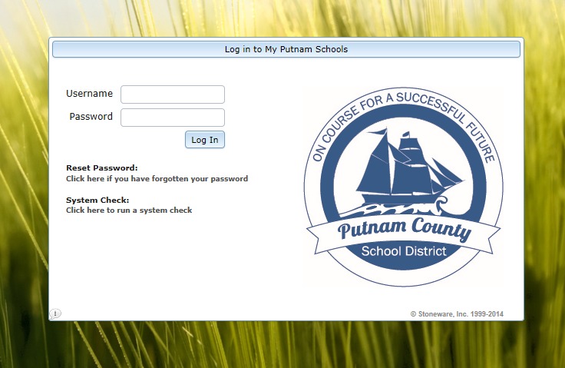
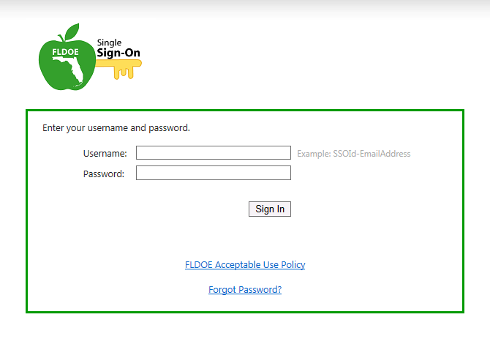
Step Five
Enter the username and password and proceed to log in.
Federated
Hosted

Slide 22
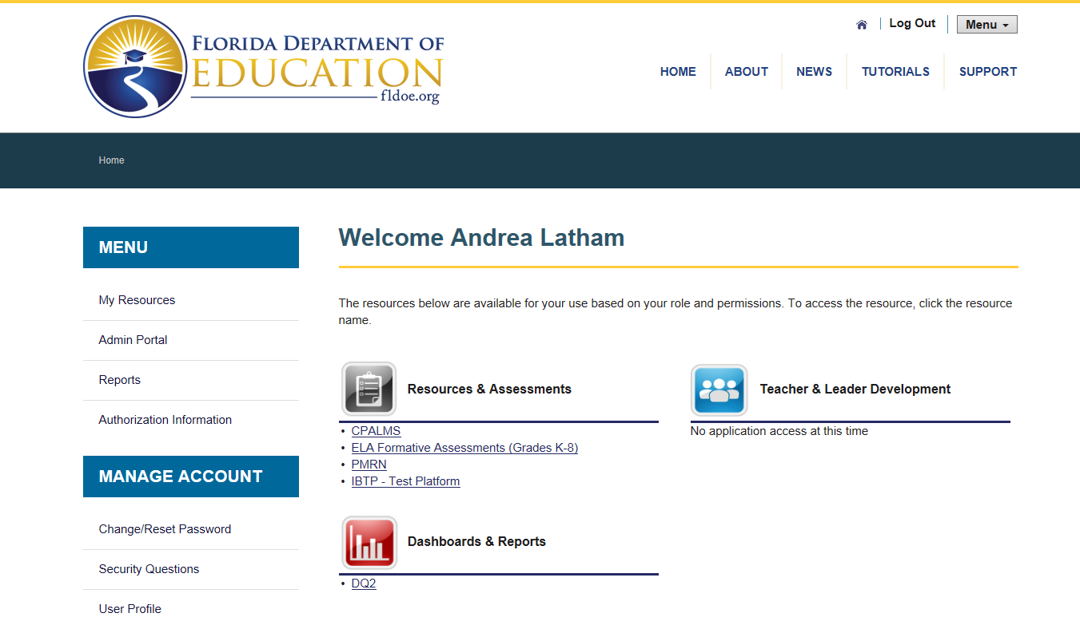
Done! Click on a Resource
The secure SSO page is displayed with your name and authorized resources.

Slide 23
Starting from Scratch
Once the organization is selected, it is stored as a cookie on the computer.
If you ever need to clear it and start the login from scratch, delete your internet browser cookies.
See Deleting Internet Browser Cookies on the Support page for more information.

Slide 24
Questions?
Support Page
Look up local helpdesk information
https://portal.fldoesso.org/PORTAL/Sign-on/Resources/Support.aspx
Service Center
ienhelp@fldoe.org
1-855-814-2876
Weekdays 7:00 AM to 6:00 PM (EST)

Slide 25
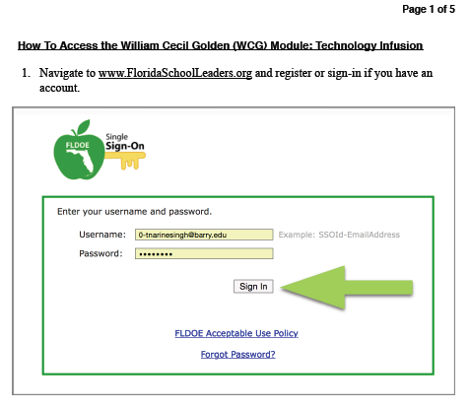
Accessing the
WCG Module 5A &
8A

Slide 26
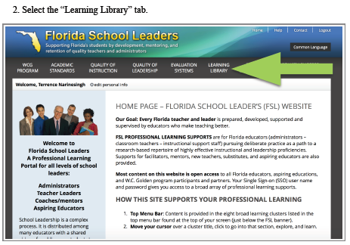
Accessing the
WCG Module 5A &
8A

Slide 27
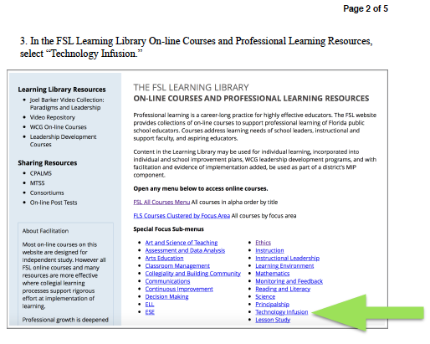
Accessing the
WCG Module 5A &
8A

Slide 28
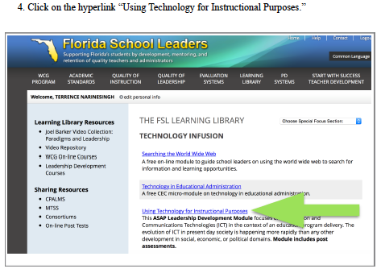
Accessing the
WCG Module 5A &
8A

Slide 29
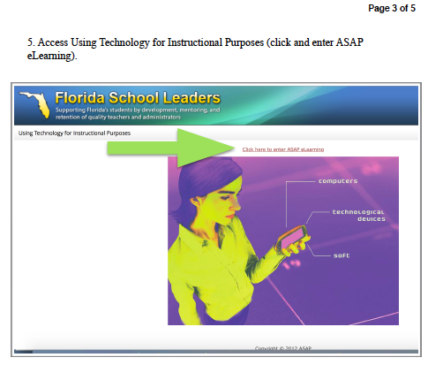
Accessing the
WCG Module 5A &
8A

Slide 30
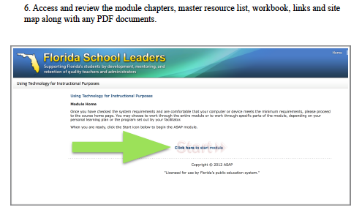
Accessing the
WCG Module 5A &
8A

Slide 31
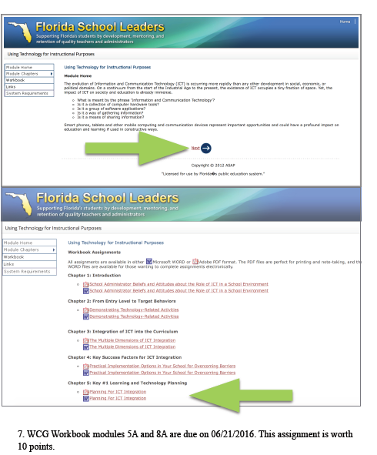
Accessing the
WCG Module 5A &
8A

Slide 32
References
APA (2010). Publication manual of the American Psychological Association (6th ed.). Washington, DC:
American Psychological Association.
Florida principal leadership standards (n.d.). Retrieved June 12, 2016, from https://
www.floridaschoolleaders.org/fslPortal/wcgProgram/fpls.aspx
Florida School Leaders. (2016, June). The William Cecil Golden school leadership development program. Retrieved from
the Florida Department of Education website https://www.floridaschoolleaders.org/
Picciano, A. G. (2009). Educational leadership and planning for technology (5th edition).
Upper Saddle River, NJ: Prentice Hall
Quijada, A. (2013). Creating critical thinkers through media literacy: Andrea Quijada at TEDxABQED.
Retrieved June 12, 2016, from https://www.youtube.com/watch?v=aHAApvHZ6XE
Support. (n.d.). Retrieved June 13, 2016, from https://portal.fldoesso.org/PORTAL/Sign-on/Resources/Support.aspx

